Slide 1
Search and the Future of Search
By Serena Carpenter
http://serenacarpenter.com
@drcarp

Slide 2

Search Smarter

Slide 3
Google
Defaults to 10 – BAD
Vary keywords
Math

Slide 4
Quotations
serena carpenter vs “serena carpenter”
Notes:
Get to know the usage of quotes if you don’t already. Delete the word “the”

Slide 5
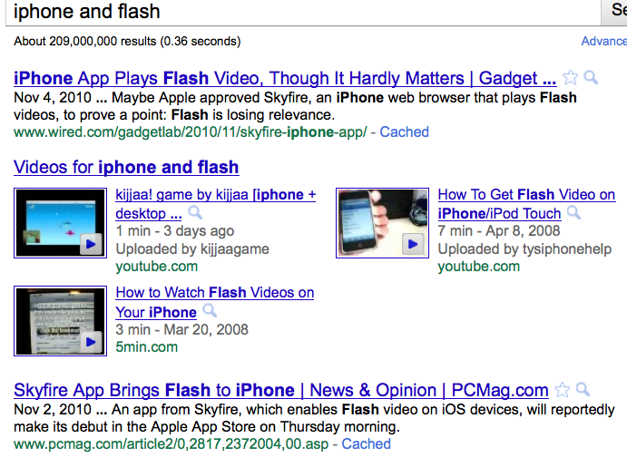
and
Notes:
I only want to see results that contain all of what I’m searching for.” For example, doing a search for cats dogs has the potential to return results about only cats, only dogs, or cats and dogs. If you want to see to it that you see only results including cats and dogs,

Slide 6
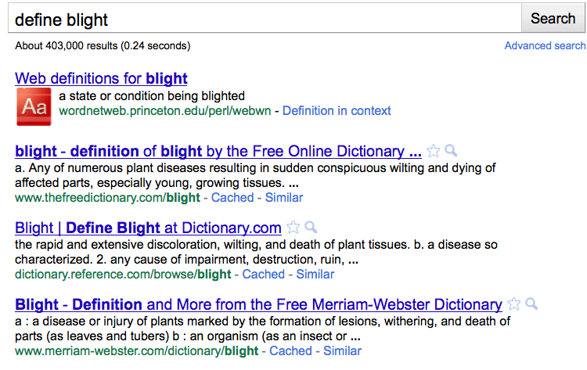
define
define public domain

Slide 7
site:
site:edu “Search Engines”
site:harvard.edu “Search Engines”
iraq site:nytimes.com
iraq site:.gov
Notes:
site: operator basically tells Google “I want you to only show me results from specific Web sites or domains I specify.”

Slide 8
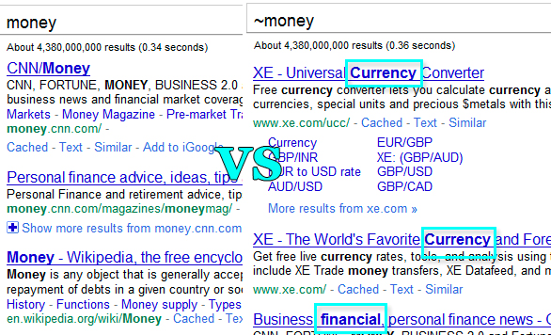
~
Notes:
However you can let Google use more synonyms and even focus the results on them. The ~ operator prompts Google to use more synonyms and related searches which gives you more clues on the topic:

Slide 9
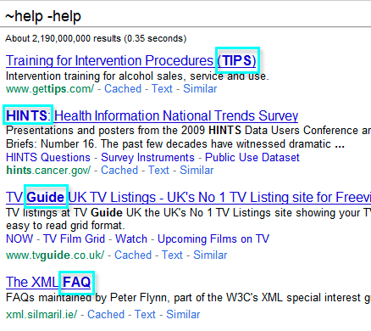
- jaguar -cars -football
Notes:
And you can even prompt Google to search only for synonyms excluding the base search term from search results:

Slide 10
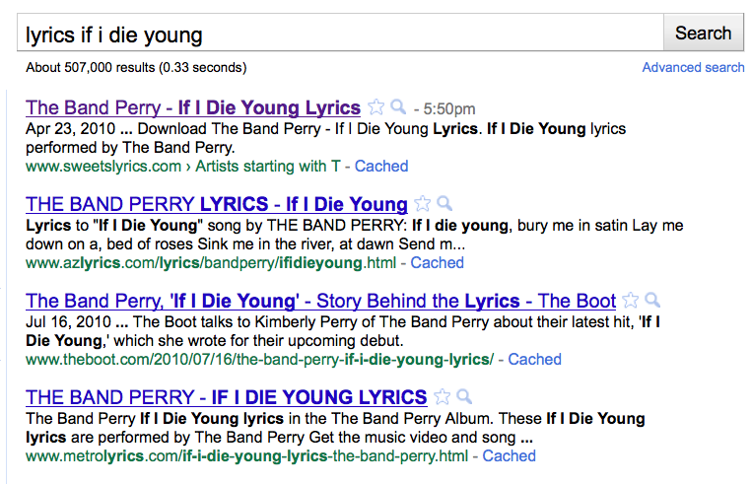
lyrics

Slide 11
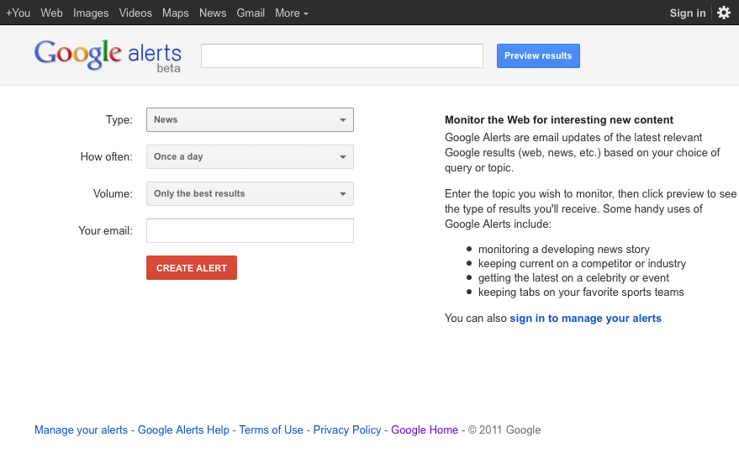

Slide 12
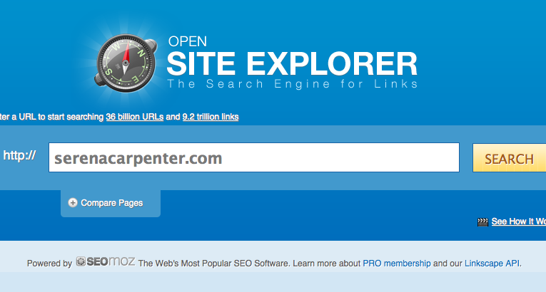
Open Site Explorer
Notes:
he Search Engine for Links

Slide 13
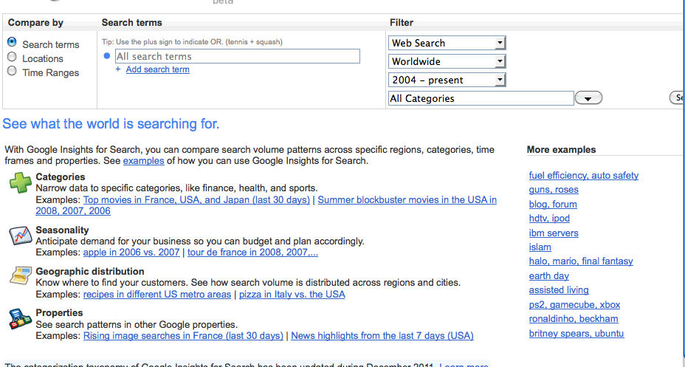
Google Insights
Notes:
if you’re a journalist looking to anticipate what readers are looking for, or if you’re looking for a historical search pattern.

Slide 14

Wayback Machine
Notes:
http://www.archive.org/web/web.php
150 billion web pages archived from 1996 to a few months ago.
The Internet Archive's Wayback Machine allows you to search for Web pages no longer accessible to the public. Browse by date through over 150 billion pages archived since 1996.
For Dead Links, use Internet Archive to find a version of these sites. Highlight and copy the URL, then go to the Way Back Machine at http://www.archive.org/index.html and then paste the URL into the web address box.

Slide 15
Domain Owner
who.is
domaintools
aboutus
Notes:
Contact information…. Assess credibility of website. Contact page, credentials,

Slide 16
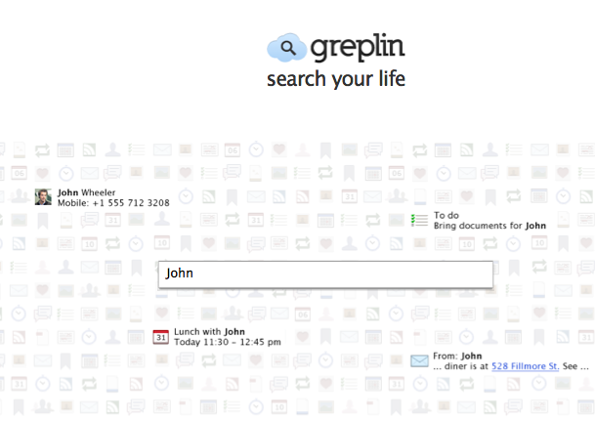
Greplin
Notes:
"Greplin the search bar for your life." Greplin is a personal search engine that allows you to search all your online data in one easy place. Greplin indexes the information you create on different websites (like Gmail, Twitter and Facebook) and provides lightning fast search of all your information. Link your social media sites to Greplin.
Greplin to help users find stories they saw earlier and are trying to find again.

Slide 17
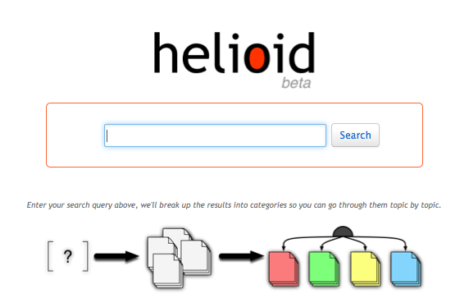
Helioid
Notes:
Helioid that colour codes results, making it more visually appealing. Firefox Chrome plugi
the column on the left presents categories generated from the text of your search results
the color of the category boxes on the left coincides with the color of the result boxes in the center/right column.
each box represents a different result and is color coded to match its assigned category.

Slide 18

DuckDuckGo
Notes:
Does not collect your history. Protect yourself from searching your computers and history. http://duckduckgo.com/ Use it to get way more instant answers, way less spam and real privacy, which we believe adds up to a much better overall search experience. See our about page for more.
Her Homepage
Wikipedia entry
Articles about
Tour information
IMDB page
Biography pages etc.
Definitions and wikipedia style results. Lady Gaga focuses on site with information on a topic. Basically they are all sites with information about her. Now switch to “Shopping” search by clicking the small trolley/cart by the query box. The results are; Zero-click results…. Rather than having to click on each site, provides summaries

Slide 19
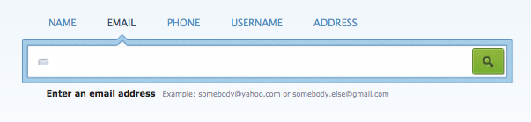
Spokeo
Notes:
Find personal info if you know someone's email address bc people use the same email on mult. accounts. Username. email, name,

Slide 20
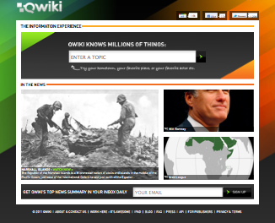
Qwiki
Notes:
and how Qwiki (http://www.qwiki.com) could be used to engage usersbetter. iPad app
Qwiki is working to deliver information in a format that's quintessentially human – via storytelling instead of search. We've all seen science fiction films (or read novels) where computers are able to collect data on behalf of humans, and present the most important details.

Slide 21
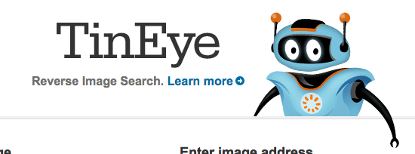
TinEye
Notes:
crawled the website or page where it appears. It finds out where an image came from, how it is being used, if modified versions of the image exist, or if there is a higher resolution version.

Slide 22
Web Scraping
Needlebase
ScraperWiki
Nutch
Heritrix
Notes:
Apache Nutch is an open source web-search software project. Stemming from Apache Lucene, it now builds on Apache Solr adding web-specifics, such as a crawler, a link-graph database and parsing support handled by Apache Tika for HTML and and array other document formats.

