Slide 1
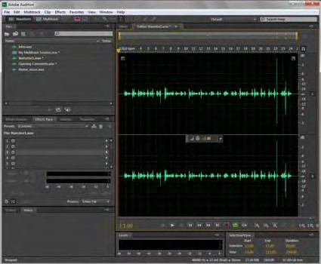
Adobe Audition
Project 7 guide
How to apply Adobe Audition sound effects
Adobe Audition is an audio application designed for video editors, web designers and developers, motion- graphics artists, and other creative professionals. Using Adobe Audition, you can edit single audio files in the Waveform Editor or you can work on multitrack audio sessions in the Multitrack Editor.
Audition includes a large collection of sound effects. An effect is an easy way to distort or modify a sound. You can use effects to improve sound quality by reducing hiss, hum, and other unwanted noises in your original recordings. There is even a set of effects that improve the sound of voices: female, male, or music vocals. For more information on using effects to reduce noise, refer to the “How to edit audio tracks” guide.
You can also use effects to modify or distort sounds to match the story, scene, or imagery in a video clip. For example, your movie may include a telephone conversation, but the dialog was recorded in a studio. No problem. Open the recording in Adobe Audition and apply the On The Telephone effect preset.
You can apply effects directly to an audio file in the Waveform Editor by selecting an effect in the Effects menu. You can also add multiple effects to the same file or track in a multitrack session by using an Effects Rack. An Effects Rack enables you to blend multiple effects, adding and removing them until you get the result you want. Adobe Audition effects should not be confused with royalty-free sound effects, sometimes referred to as sound fx, that you can downoad and use to create a movie soundtrack. Royalty-free sound effects are explained in the “How to use loops, music beds, and sound effects” guide.
In this guide, you apply Adobe Audition built-in sound effects and filters to an individual file and to a multitrack session.
Adding sound effects to a file in the Waveform Editor
You can add an effect to a file in the Waveform Editor by selecting it from the Effects menu or by using the Effects Rack panel. Using the Effects menu applies the sound to the file automatically. When you add effects in the Effects Rack panel, you can preview and test them before applying the entire rack of effects to the file.
To add a sound effect to a file by using the Effects menu:
1. Start Adobe Audition and open an audio file in the Waveform Editor panel (Figure 1).
Figure 1 Waveform Editor panel
© 2012 Adobe Systems Incorporated
How to apply Adobe Audition sound effects
1

Slide 2
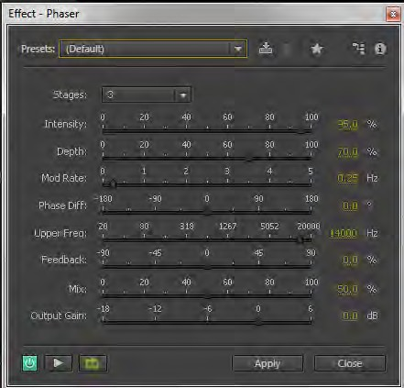

Project 7 guide
Adobe Audition
Select Effects > Modulation > Phaser.
The Effect–Phaser dialog box appears (Figure 2).
Click the Toggle Loop button to the on (green) state (Figure 3).
Open the Presets menu (Figure 2) and select Brainball.
Click the Preview Play button to preview the effect (Figure 3).
As the effect plays, you can use the sliders in the dialog box to modify the effect in real time.
Let the effect continue to play while you open the Presets menu and select a new preset, such as Log Drummer.
Note: For each effect, you can select from several presets, or modify the settings in the dialog box and then save them as a new preset by clicking the Save Settings As A Preset button (Figure 2).
Test a few other presets. When you have finished, click the Stop button (Figure 3).
When you’ve found a preset or settings you like, click Apply to add the effect to your file.
Note: You can click Close to close the Effect dialog box without adding the effect.
Play the file in the Waveform editor.
The effect is added to the file. The effect is not added in the Effects Rack panel.
Note: When you save the file, the effect is permanently added to the file stored on your computer. To remove the effect, select Edit > Undo before you save the file, or close the file without saving your changes.
Presets menu
Save Settings As A Preset button
Figure 2 Effect–Phaser dialog box
Toggle Power Preview Play/Stop Toggle Loop button button button
Figure 3 Effect–Phaser dialog box
2
How to apply Adobe Audition sound effects
© 2012 Adobe Systems Incorporated

Slide 3
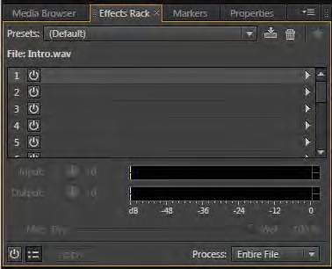
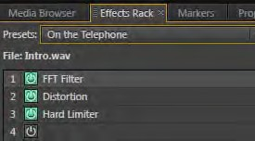
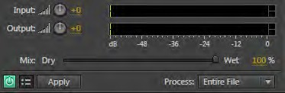
Adobe Audition
Project 7 guide
To add effects to a file by using the Effects Rack panel:
Start Adobe Audition and open an audio file in the Waveform Editor.
Make sure the Effects Rack panel is visible (Figure 4).
Each file has 16 effect slots. To add effects to the rack, you can choose a preset in the Presets menu or open the Effects pop-up menu (on the right of each slot) and locate the effect.
In the Effects Rack panel, open the Presets menu (Figure 4) and select On The Telephone.
Some presets include more than one effect. The On The Telephone preset applies three effects (Figure 5) that combine to make your audio sound as if it’s a recorded telephone conversation.
Note: You can double-click on any of the effects in the Effects Rack panel to modify its properties.
Play the sound file in the Waveform Editor to hear the effect.
As the file plays, use the Toggle Power State button (Figure 5) beside each effect to toggle it off and on and listen to the clip with and without that effect applied.
Note: You can toggle the entire rack of effects on or off by using the Master Toggle Power State button in the lower-left corner of the Effects Rack panel (Figure 6).
As the file plays, use the Mix slider in the Effects Rack to adjust the intensity of the effect (Figure 6).
Note: 100% (Wet) equals fully processed audio; 0% (Dry) equals original, unprocessed audio.
You can also use the Input and Output adjustments to control the incoming sound level of the file and the output sound level of the file after you have added effects. Adjust these settings as needed to prevent the modified file from clipping.
In Waveform view, effects in the rack are not applied to the sound file until you click the Apply button or save the file. If you don’t like an effect, just select it in the Effects Rack panel and press Delete.
Presets menu
Empty effect slots
Effects pop-up menu
Figure 4 Effects Rack panel–Waveform view
Toggle Power State buttons
Figure 5 Effects Rack, with On The Telephone preset
Input/Output adjustments
Mix slider
Master Toggle Power State button
Figure 6 Effects Rack
© 2012 Adobe Systems Incorporated
How to apply Adobe Audition sound effects
3

Slide 4
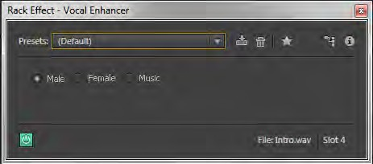
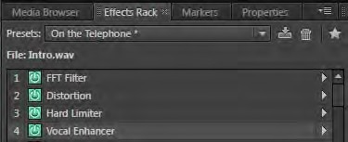

Project 7 guide
Adobe Audition CS6
Open the Effects pop-up menu for an empty slot in the Effects Rack. Select Special > Vocal Enhancer.
The Rack Effect–Vocal Enhancer dialog box appears (Figure 7). The effect appears in the Effects Rack panel. This effect improves the quality of voice-over recordings. The Male and Female modes automatically reduce sibilance and plosives, as well as microphone-handling noise such as low rumbles. Those modes also apply microphone modeling and compression to give vocals a characteristic radio sound. The Music mode optimizes soundtracks so they better complement a voice-over.
Select the Female option and close the dialog box.
Once you are satisfied with your collection of effects, you can save the entire rack as a new preset.
In the Effects Rack panel, click the Save Effects Rack As A Preset button (Figure 8), name the new preset Female On The Telephone, and click OK.
Open the Effects Rack Presets menu (Figure 10).
The new preset appears in the menu. You can now apply the new combination of effects to other files.
Note: To delete a preset, select it in the menu, and then click the Delete Preset button (trash can).
Open the Process menu at the bottom of the Effects Rack panel, and select Entire File.
You can apply effects to a selection or the entire file.
Click Apply in the Effects Rack panel.
The entire rack of effects is applied to the file, and the Effects Rack is cleared. You can now apply 16 additional effects to the same file in a new rack.
Note: When you save the file, the effects are permanently added to the file on your computer. To undo the changes after applying effects, you can select Edit > Undo before you save the file, or close the file without saving changes.
Figure 7 Rack Effect–Vocal Enhancer dialog box
Modified preset
Save Effects Rack As A Preset button
Figure 8 Effects Rack panel
Figure 9 Effects Rack Process menu
4
How to apply Adobe Audition sound effects
© 2012 Adobe Systems Incorporated

Slide 5
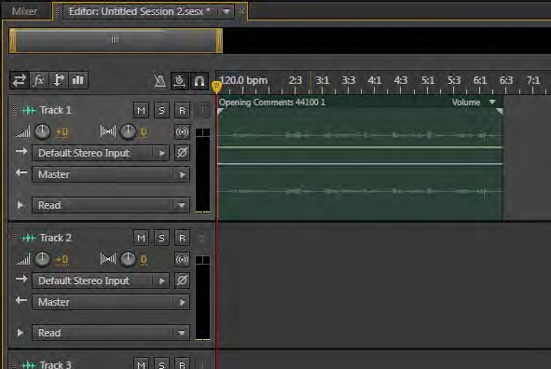

Adobe Audition
Project 7 guide
Adding effects to tracks in a multitrack session
Adding effects in a multitrack session is similar to adding effects to a single file in the Waveform Editor, but there are a few key differences:
Each track in a multitrack session can have its own rack of 16 effects.
Track effects apply to all files or clips in the track.
You can also apply effects to the individual files or clips in a track. When you do, the file or clip includes both the clip effects and any overlying track effects.
Effects you add to tracks in a multitrack session appear in the Effects Rack panel. This is true whether you add the effect from the Effects menu or from an Effects pop-up menu in the Effects Rack panel.
Effects you add to tracks or clips in a multitrack session appear in the Effects Rack panel. You don’t need to click Apply. The effects are applied to the multitrack session file (.sesx) when you save it.
You cannot apply process effects to tracks or clips in a multitrack session. Process effects are identified in the Effects menu by the word (process) in parentheses. To apply process effects, open the file in the Waveform Editor view, apply the effect, save the file, and add the modified file to your multitrack session.
To add effects in a multitrack session:
Start Adobe Audition and start a new multitrack session in the Multitrack Editor.
Drag a file from the Files panel to Track 1 in the multitrack session (Figure 10).
Note: For this activity, use a file that does not already include effects.
Select the track in the Multitrack Editor panel (a track that contains an audio file).
Note: You can select the track header or click on any clip in the track to select it.
In the Effects Rack panel, make sure Track Effects is selected (Figure 11).
Effects will apply to all files or clips in the current track.
Figure 10 Multitrack Editor panel
Figure 11 Effects Rack panel
© 2012 Adobe Systems Incorporated
How to apply Adobe Audition sound effects
5

Slide 6
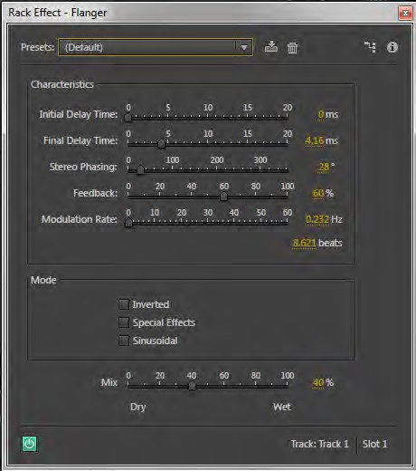

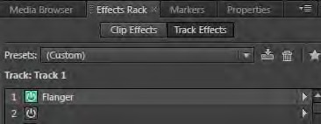
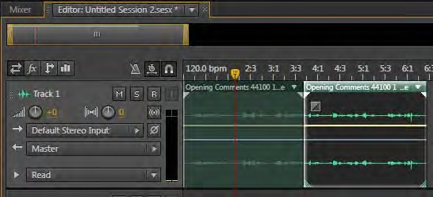
Project 7 guide
Adobe Audition
Select Effects > Modulation > Flanger.
The Rack Effect–Flanger dialog box appears
(Figure 12). Notice there is no Apply button in the dialog box. Effects you add to tracks in a multitrack session are added to the Effects Rack panel automatically.
Move the dialog box until you can see the Transport controls at the bottom of the Editor panel.
In the Transport controls (Figure 13), click the Loop Playback button to the on (green) state and click the Play button to hear the effect.
As the effect plays, open the Presets menu in the dialog box and select a new preset, such as Buzzed. Experiment with various presets and settings.
When you find an effect and settings you like, click the Stop button in the Transport controls, and then close the Effects–Flanger dialog box.
The effect appears in the Rack Effects panel for the current track (Figure 14).
Add a second file to Track 1 or use the Razor Selected Clips tool to split the first file into two clips.
With two files or clips in the same track, you can now add effects to the entire track or to the individual clips.
Using the Move tool, select the second file or clip in Track 1 (Figure 15).
Figure 12 Rack Effect–Flanger dialog box
Stop button
Play button
Loop Playback button
Figure 13 Transport controls in the Multitrack Editor
Figure 14 Effects Rack panel
Figure 15 Two clips in Track 1
6
How to apply Adobe Audition sound effects
© 2012 Adobe Systems Incorporated

Slide 7
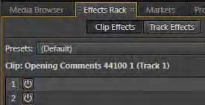
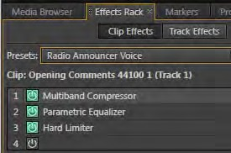

Adobe Audition
Project 7 guide
In the Effects Rack panel, select Clip Effects.
The name of the selected clip and track appears in the Effects Rack (Figure 16). Now, any effects you add will apply to the selected clip only.
In the Effects Rack panel, select a preset effect, or click the Effects pop-up menu for an empty effect slot and apply an effect of your choice.
The preset or effects appear in the Effects Rack for the selected clip (Figure 17).
In the Multitrack Editor panel, select the first clip in Track 1.
Notice that in the Effects Rack panel, this clip has no effects.
In the Effects Rack panel, select Track Effects.
The same track effects apply to all clips in Track 1, but each individual file or clip can have its own rack of 16 effects.
Note: The Effects Rack for a track in a multitrack session has two buttons that do not apply to individual clips or to files in the Waveform Editor. These include the
FX Pre-fader/Post-fader button and the Pre-render Track button (Figure 18).
Figure 16 Effects Rack panel for a selected clip
Figure 17 Clip Effects in the Effects Rack panel
FX Pre-fader/Post-fader button
Pre-render Track button
FX Pre-fader/Post-fader button: Refers to functions that happen either before (pre-fade) or after (post- fade) the main fader of a channel in a mixing board.
Pre-render Track button: Reduce the demand on your computer CPU by engaging the Pre-render Track button, which applies effects to the entire track without locking you out of the effects parameter controls.
Figure 18 Effects Rack panel–Track Effects
© 2012 Adobe Systems Incorporated
How to apply Adobe Audition sound effects
7

