Slide 1
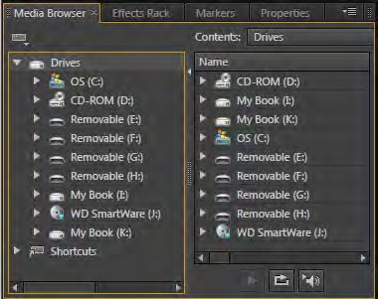
Adobe Audition
Project 7 guide
How to use loops, music beds, and sound effects
When creating a movie soundtrack, you may want to include royalty-free music and sound effects. Royalty-free means you don’t need to pay royalties or worry about copyright violation when you add them to your project. Most royalty-free sound libraries include collections of loops, music beds, and sound effects.
A loop is created when you repeat a single piece of music or a short sound clip for as long or short a period as you need for your soundtrack. Loops usually contain one or two bars of music. In many musical styles, you’ll find loops used for everything from basic rhythm tracks to entire compositions.
A music bed is a longer piece of background music you can layer with other music beds and loops to create an original score or composition. Music beds are usually designed so they can also be trimmed down or looped to create a soundtrack of any length.
Sound effects, also referred to as sound fx, are short audio recordings that add realism or dramatic effect to a soundtrack. For example, your movie may require the sound of a door slamming, a bird chirping, a crowd cheering, or the wind howling.
Note: Royalty-free sound effects should not be confused with the Adobe Audition effects you can apply to audio files to modify sound quality or reduce noise. Adobe Audition sound effects are explained in the “How to apply Adobe Audition sound effects” guide.
The use of royalty-free audio files is an effective way to incorporate audio you can time perfectly to your video. Mix and match them with ease in the Adobe Audition Multitrack Editor to create an original score or soundtrack.
In this guide, you use a multitrack session and royalty-free sound loops to create a layered movie soundtrack.
Using royalty-free loops, music beds, and sound effects to create a soundtrack
Adobe Audition includes thousands of uncompressed, royalty-free loops, sound beds, and sound effects. These files are available as ZIP file archives you can download by selecting Help > Download Sound Effects And More or by pointing your web browser to: www.adobe.com/go/audition_extras
When you download royalty-free files, you can store them in a folder on your computer’s hard drive or network drive, and then use the Media Browser panel (Figure 1) in Adobe Audition to locate and preview sounds before adding them to a soundtrack.
To preview sounds in the Media Browser panel:
Start Adobe Audition.
Select Window > Workspace > Default to make sure the default workspace is selected and the Media Browser panel is open.
Figure 1 Media Browser panel
© 2012 Adobe Systems Incorporated
How to use loops, music beds, and sound effects
1

Slide 2
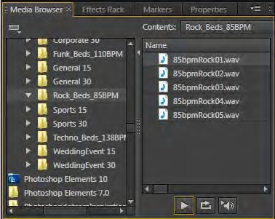
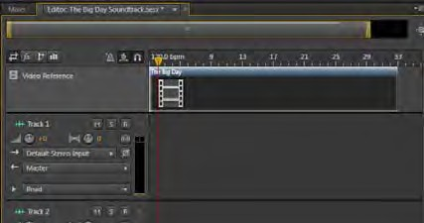
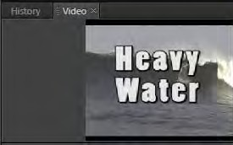
Project 7 guide
Adobe Audition
In the Media Browser panel, locate the folder that contains your royalty-free music, loops, and sounds (Figure 2).
In this example, we’ve organized our sounds into two folders— “loops” and “music beds.”
To preview a sound file, select it in the Media Browser panel and click the Play button (Figure 2).
The file plays. Notice that the file may be very short. It may be just a single sound effect, a couple of beats, or a few bars of music. You can extend this by looping.
Note: When the Auto-Play button (Figure 2) is selected, sound files play automatically when you click on them in the Media Browser panel. Leave this turned off for now.
In the Media Browser panel, click the Loop Playback button (Figure 2) to select it.
Select a sound file and click Play.
This time the file loops continuously until you click the Stop button. This is a good example of how looping can be used to create music or sound effects of any duration.
Click the Stop button.
Play/Stop button
Loop Playback button
Auto-Play button
Figure 2 Preview sounds in the Media Browser
To add loops and sounds to a multitrack session:
Click the View Multitrack Editor button to start a new multitrack session.
The New Multitrack Session dialog box appears.
Enter a name for the multitrack session and click OK. When creating a music score for video, it’s a good idea to load a copy of the video into the multitrack session. This makes timing the score to your movie a lot easier.
3. To import a video preview, select File > Import > File.
Select a video file and click Open. Drag the video file from the Files panel to the first track in the Multitrack Editor panel.
A new video preview track is added as the top-most layer in the multitrack session (Figure 3). You may need to drag the video clip to the left to position it at the beginning of the track.
When you play the multitrack session, the video appears in the Video panel (Figure 4).
Figure 3 Video track in a multitrack session
Figure 4 Video panel
2
How to use loops, music beds, and sound effects
© 2012 Adobe Systems Incorporated

Slide 3
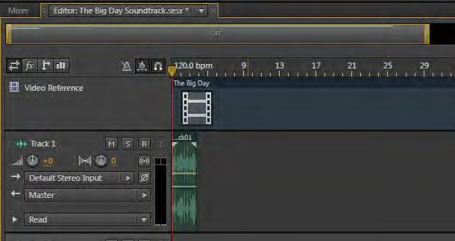
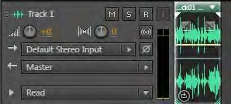
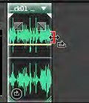
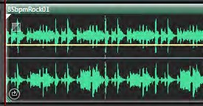
Adobe Audition
Project 7 guide
4. Drag a sound file from the Media Browser panel to Track 1 in the Multitrack Editor panel.
The sound is added to the multitrack session, but it’s just a short piece of music or sound (Figure 5). You can now extend its length to match your video or other music elements you’ve added to the session. You can also add loops, sounds, and music beds to additional layers to create a multilayer soundtrack.
Next, you will extend the loop to match the duration of your video.
Figure 5 Multitrack Editor panel
To extend a loop in a multitrack session:
Continue from where you left off in the previous activity.
Position the Current Time Indicator (CTI) at the beginning of the Timeline in the Multitrack Editor panel and press the spacebar to play the loop in Track 1.
The loop plays for just a few seconds. You can copy and paste the loop in Track 1 to extend it, but there is a better way to extend a loop.
Select the sound file in Track 1, and select Clip > Loop.
The Loop icon appears in the lower-left corner of the clip in the Multitrack Editor (Figure 6).
Position the pointer along the right edge of the loop clip in Track 1.
The pointer changes to the Trim Loop pointer (Figure 7).
Drag the edge of the loop clip to the right until it matches the duration of the video clip (or whatever length you want to make it.).
The loop repeats automatically for the duration of the clip. If you look closely, you can see thin dotted vertical lines that represent the location at which the loop repeats (Figure 8).
Loop icon
Figure 6 Loop clip in the Multitrack Editor
Figure 7 Trim Loop pointer
Lines representing where loop repeats
Figure 8 Extended loop clip
© 2012 Adobe Systems Incorporated
How to use loops, music beds, and sound effects
3

Slide 4
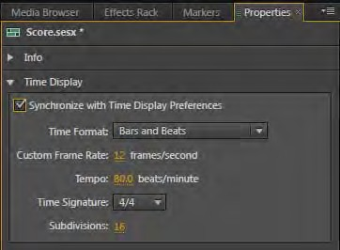
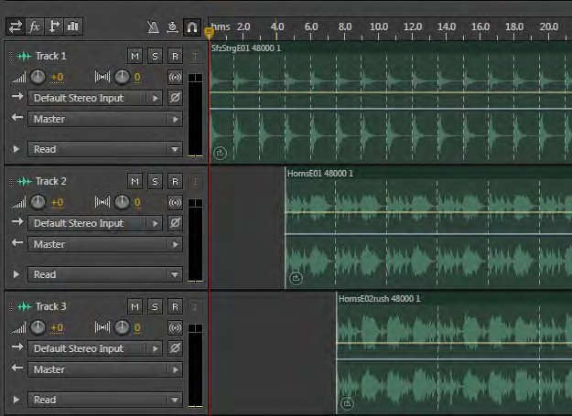
Project 7 guide
Adobe Audition
Layering sounds to create a multitrack score
You can add additional layers to the session by dragging music or additional loops and sound effects to open tracks in the multitrack session. For example, you might lay down a track of drums by using a drum loop. You could then add a layer of stringed instruments and a track of horns or a choir.
Most of the royalty-free loops indicate their tempo in the filename or folder in which they are stored, such as 85 beats per minute (85 bpm). By pairing sound loops with the same tempo, you can create very appealing scores.
To create a multitrack score by layering sounds:
Create a new multitrack session.
Right-click (Windows) or Control-click (Mac OS) any empty track in the Multitrack Editor panel, and select Session Properties.
In the Properties panel, expand the Time Display section and enter a Tempo that matches the music or sound in your project (Figure 9).
Use the Media Browser panel to locate the files to use in your score.
Drag each layer of sound into the empty tracks in the Multitrack Editor panel.
Make sure Synchronize With Time Display Preferences is selected.
This causes the time display in the active session to match the time and tempo preferences you set here in the Properties panel (Figure 10).
Convert each file into a loop and extend the tracks to the desired duration.
Not all files need to start and end at the same time. For example, the score may begin with violins and then slowly introduce other instruments or vocals.
Align the clips in each track by the gray dotted lines to make sure they play to the same beat (Figure 11).
When you’re finished creating your score, you can mix down the layered multitrack session to a single audio file for use in other files. You can add the resulting file to other multitrack sessions or to your Adobe Premiere Pro projects and Adobe After Effects compositions.
Figure 9 Multitrack session properties in the Properties panel
Figure 10 Time Display in the Multitrack Editor panel
Figure 11 Multitrack score with aligned tracks
4
How to use loops, music beds, and sound effects
© 2012 Adobe Systems Incorporated

Slide 5

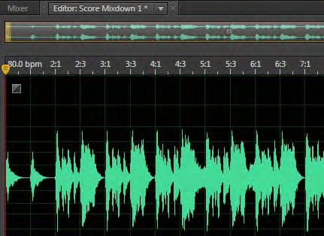
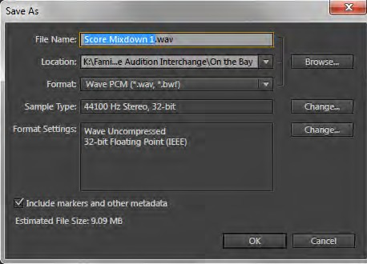
Adobe Audition
Project 7 guide
Saving a soundtrack mix to a single audio file
This process is known as exporting a mixdown of the multiple tracks. When you do so, all of the tracks are mixed into a single file: a WAV file, AIF file, MP3, or other format, depending on your preference.
For Adobe Premiere Pro, exporting sound in an uncompressed format is best. Generally, you want to leave audio files in an uncompressed format—WAV or AIF—until the last step in your editing process.
To save a score to a single audio file:
Select the multitrack session file in the Files panel.
Select Multitrack > Mixdown Session To New File > Entire Session.
A new file with the same name as the multitrack session appears in the Files panel (Figure 12). The new file opens automatically in the Waveform Editor panel (Figure 13).
Note: The file is stored in a folder named Adobe Audition Interchange.
Select the Mixdown file in the Files panel, and select File
> Save As.
The Save As dialog box appears (Figure 14).
Choose Wave PCM or AIFF from the Save As Type menu (Windows) or Format menu (Mac OS) and click OK.
Both of these formats are uncompressed. Unlike MP3, they do not discard any audio data when you save them.
The mixdown has now been saved as a single audio track suitable for use in Adobe Premiere Pro CS6.
Figure 12 Mixdown in the Files panel
Figure 13 Mixdown in the Waveform Editor panel
Figure 14 Save As dialog box
© 2012 Adobe Systems Incorporated
How to use loops, music beds, and sound effects
5

