Slide 1
Creating Video Packages
With Your iPhone
Information courtesy Cindy E. Rodriguez
Senior Journalist in Residence
Emerson College

Slide 2
You have to learn the craft.
Story is what matters most
Learn from the pros
Take classes
Watch tutorials
Examine good work

Slide 3
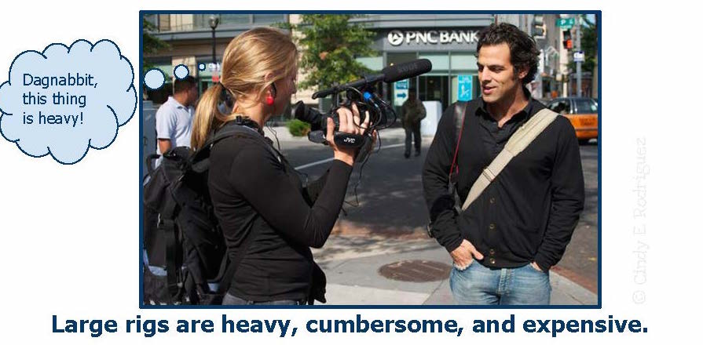
The Rationale
Large rigs are heavy, cumbersome and expensive

Slide 4
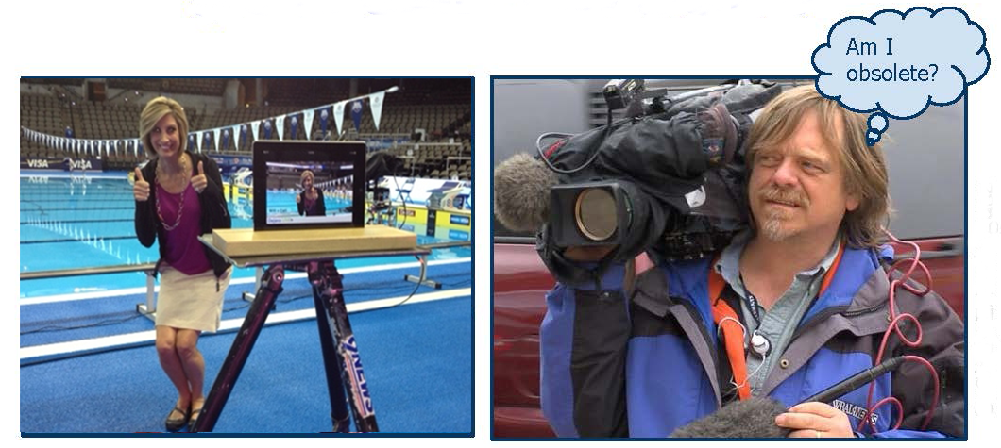
You Can Go Solo
Quality technology * Inexpensive * You are in control

Slide 5
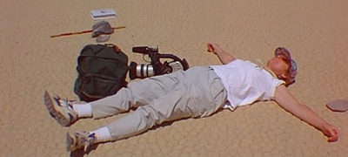
Backpack Journalism is Exhausting

Slide 6
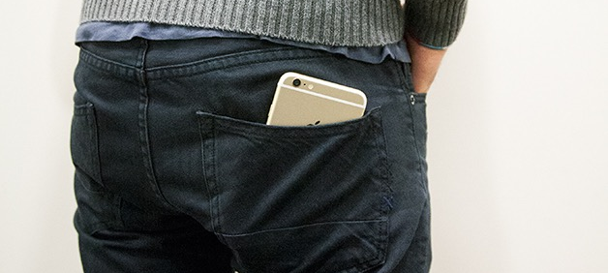
Back pocket Journalism Isn’t

Slide 7
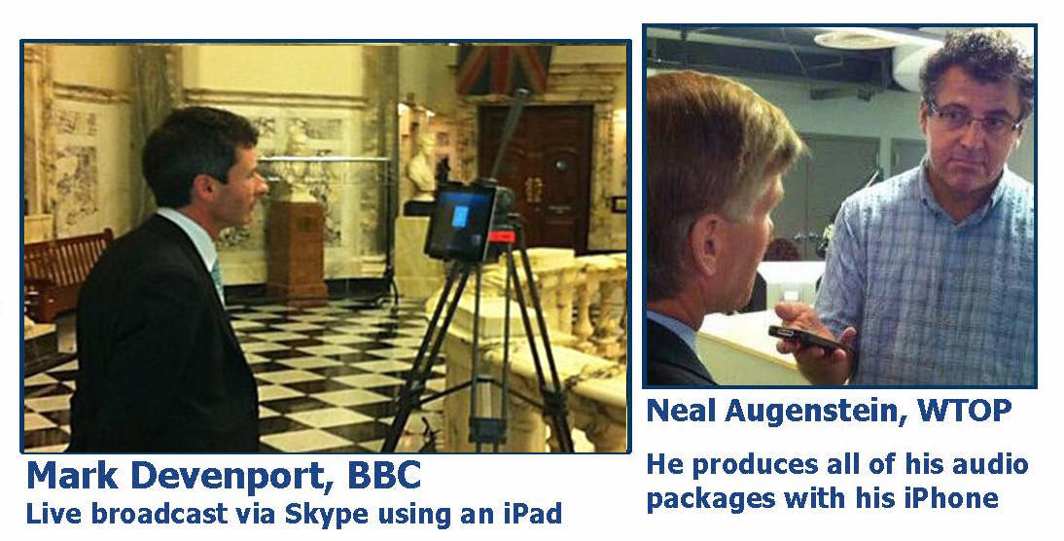
Pioneering Mojos

Slide 8
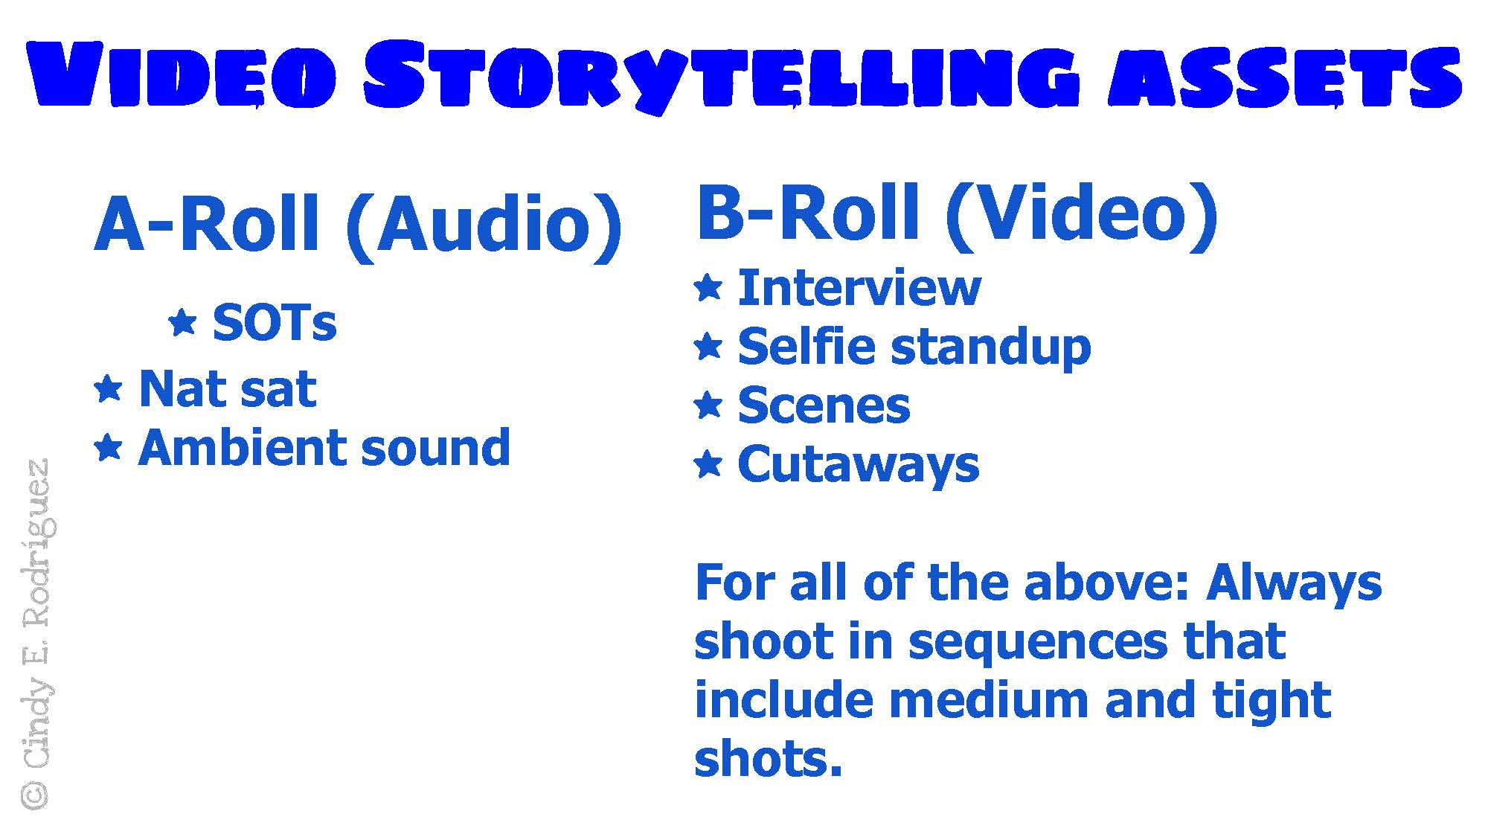
Video Story Telling Assets

Slide 9
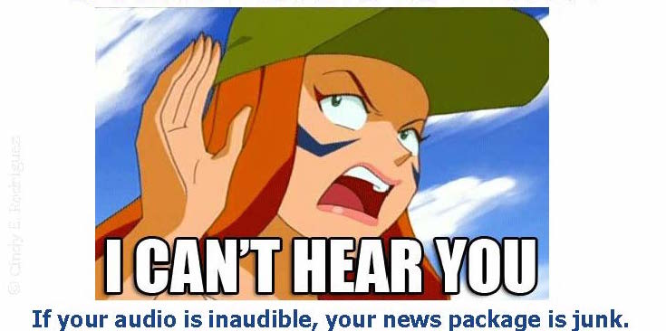
Clear Audio is Vital
If your sound is inaudible,
your package is junk.

Slide 10
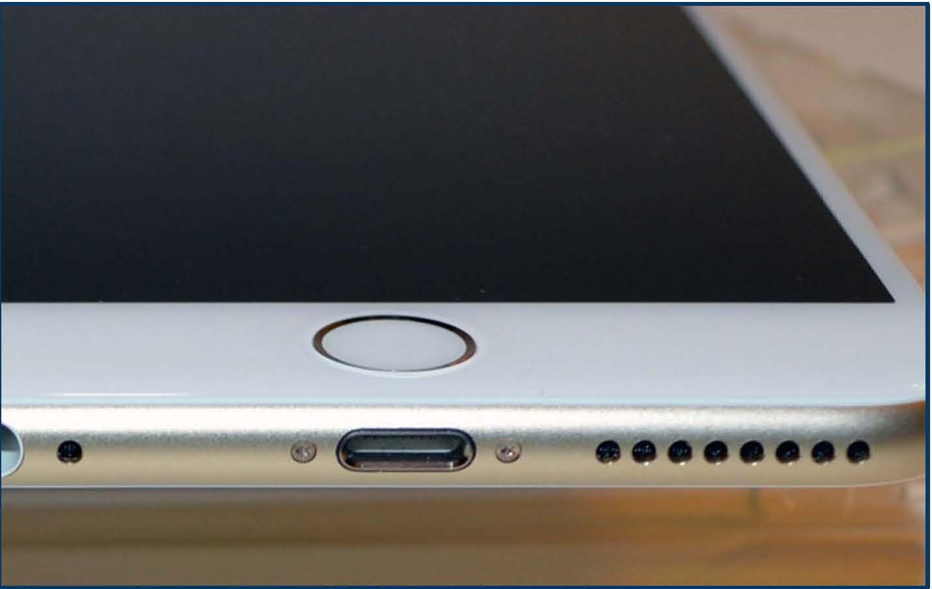
Collecting Sound Bites
Built-in mic works if you are not in a noisy place and are close to the subject.
If it is noisy, take your source somewhere quiet
The microphone is at the bottom. Don’t cover it up.

Slide 11
Collecting SOTs
aka sound bites, sound on tape or actualities
Put your source at ease
Get the person talking about him/herself
Avoid “yes-no” (close-ended) questions
Ask pointed questions.

Slide 12
Collecting SOTs
Sound bites need to be short (think bite not mouthful)
Ask specific pointed questions. If the source rambles, simplify the question.
Ideal length: approximately 8 seconds (24 words)
Script length formula: Each second = three words

Slide 13
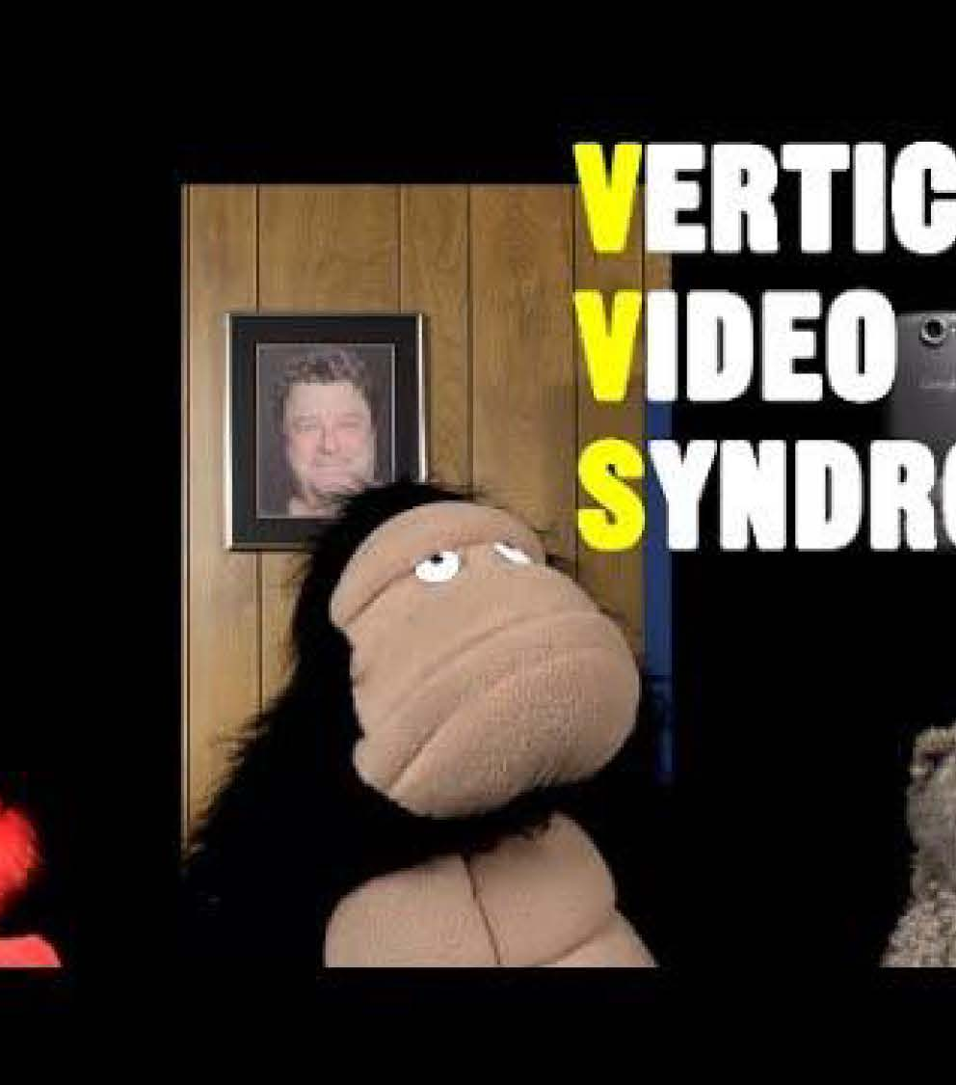
Shoot horizontal
This isn’t a selfie!

Slide 14
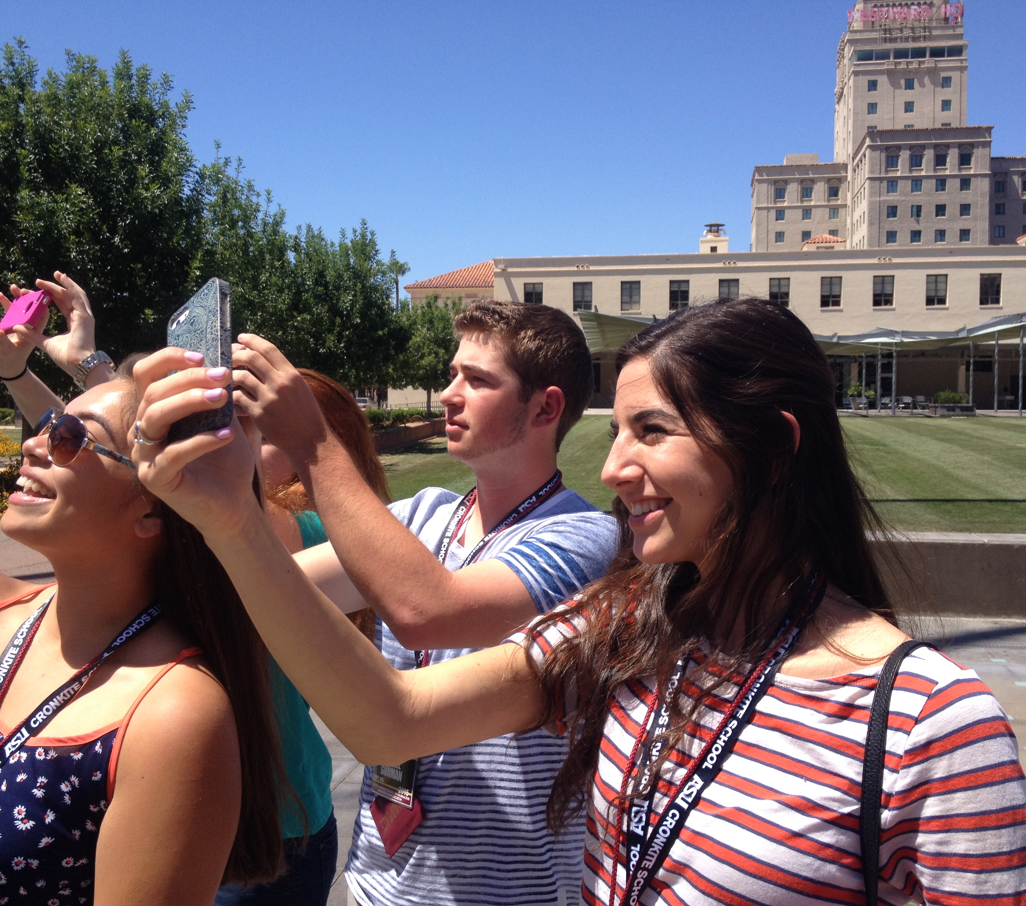
Collecting B-Roll
Shoot 10-second clips
Zoom with your feet
Fill the frame
Avoid pans and tilts
Shoot horizontally

Slide 15
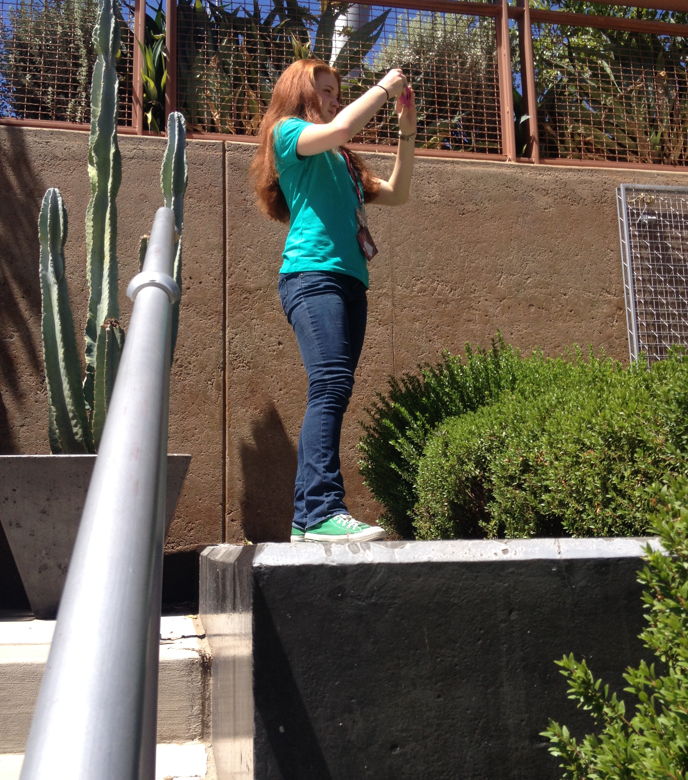
Establishing Shot
Usually Wide

Slide 16
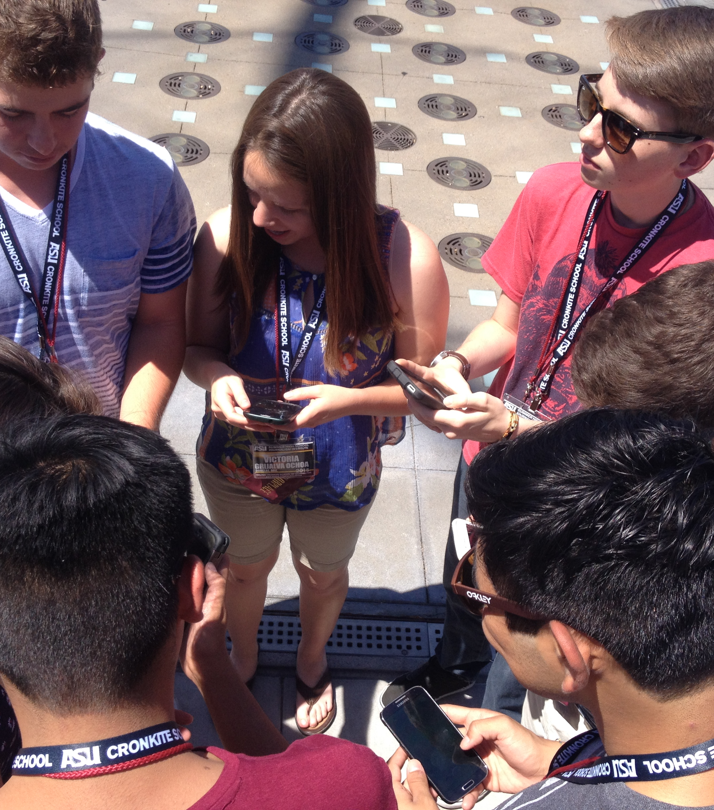
Medium Shot
Waist to top of head

Slide 17
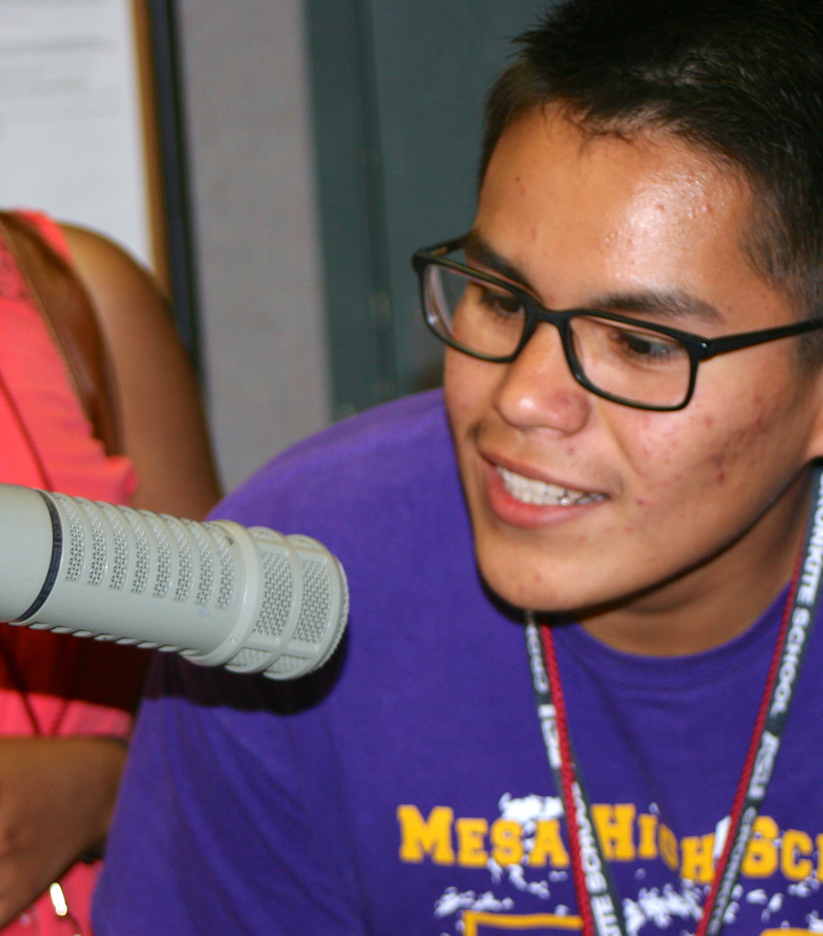
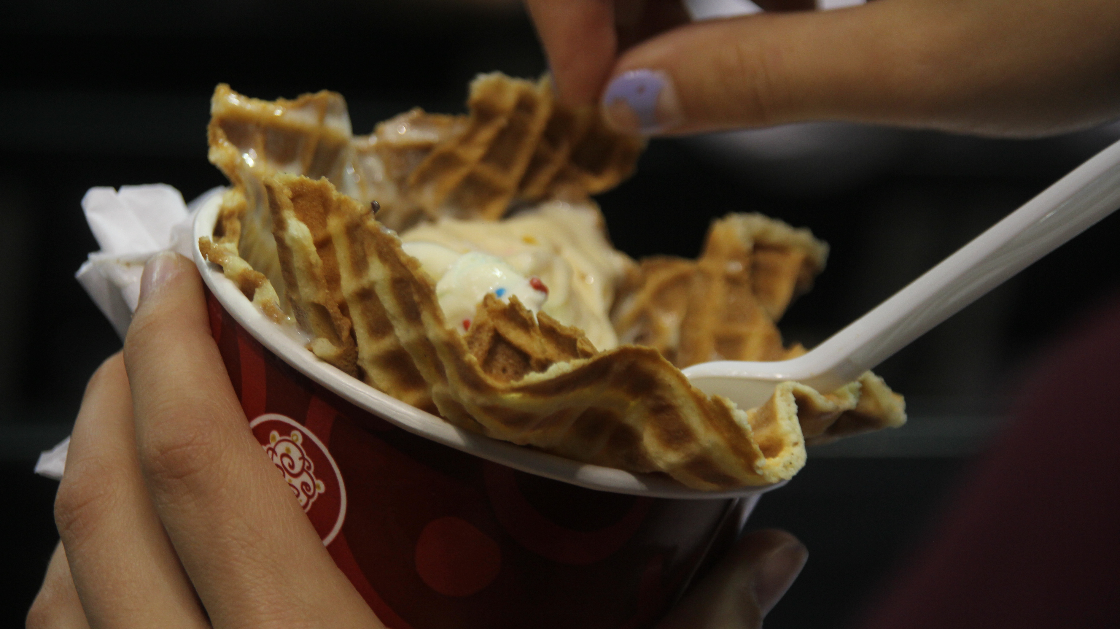
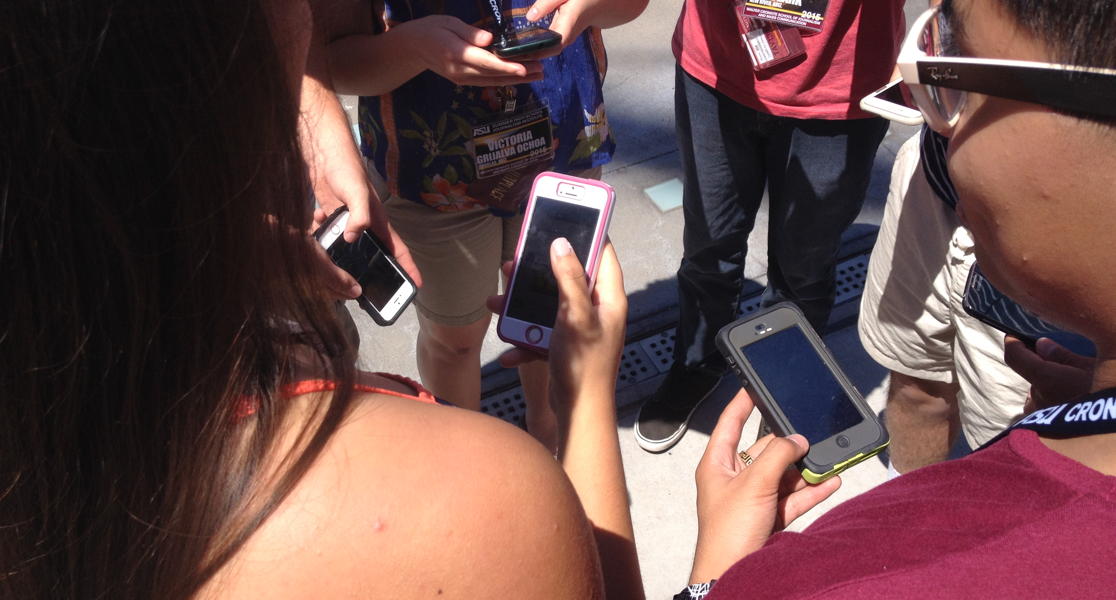
Close-up shots
Faces usually trump inanimate objects

Slide 18
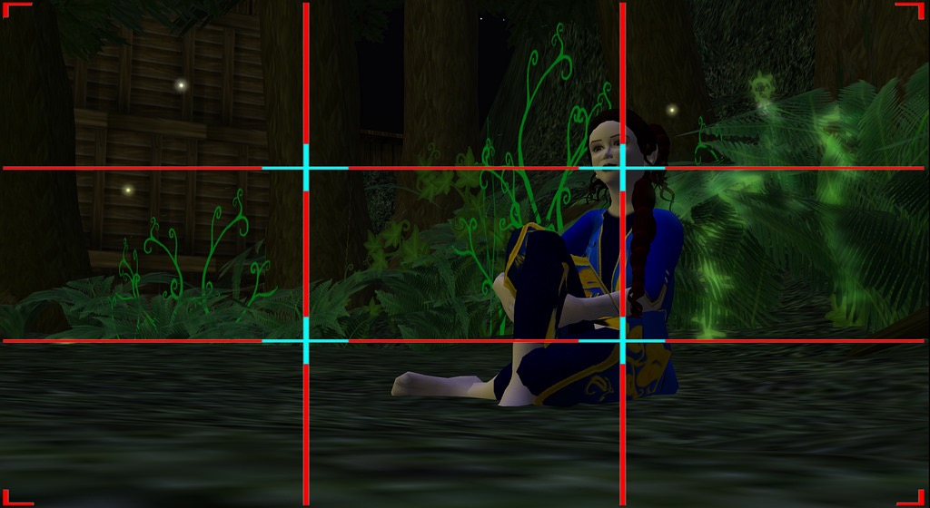
Rule of Thirds
Makes your image more dynamic and interesting

Slide 19
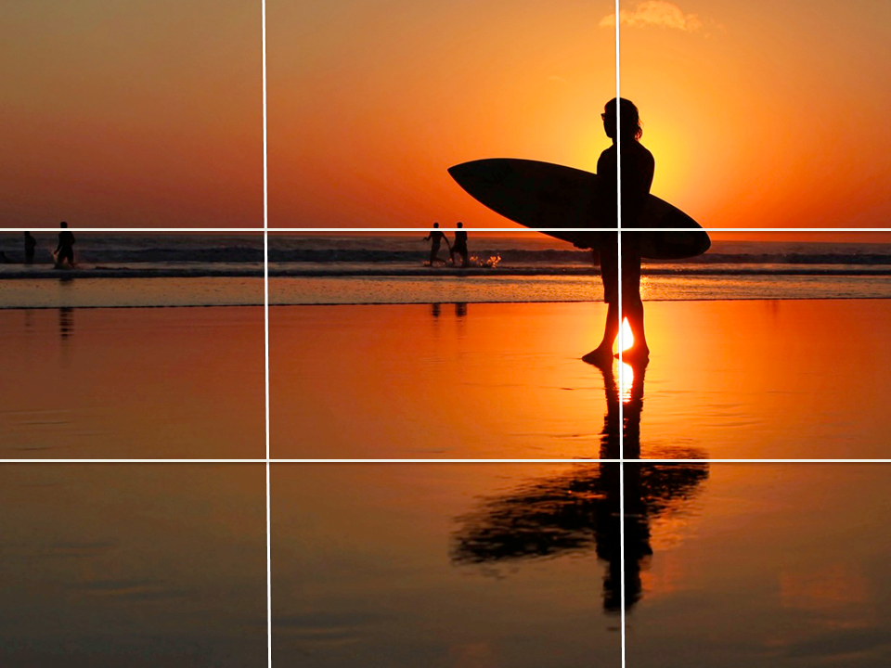
Turn on the Grid

Slide 20
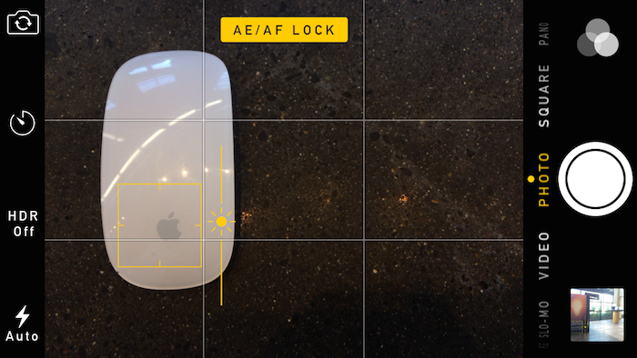
Lock Focus and Exposure
YOU decide what the camera should focus on.
Press and hold the screen until two boxes appear and pulsate.
That will lock your AE/AF
AF: auto focus
AE: auto exposure

Slide 21
Avoid Using Flash
If it is dark, find and use incandescent or natural light.
Turn on HDR (high dynamic range) for better light exposure. but only use it when you need it
If you are in a jam and it’s dark, use flash.

Slide 22
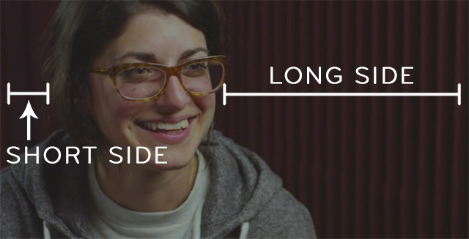
Framing Interviews
Your source should be in one of the thirds facing the “negative space” (aka open space) not the middle.

Slide 23
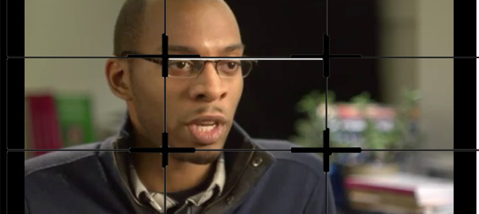
Framing Interviews
Your source should be in one of the side thirds, not in the middle.

Slide 24
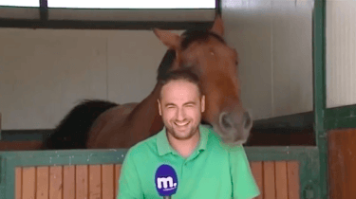
Selfie Stand-up
You are the reporter, the omniscient one. Frame in the center. Keep the shot medium or tight. Be aware of what is behind you.

Slide 25

Use a Tripod
Shaky video results in motion sickness.

Slide 26
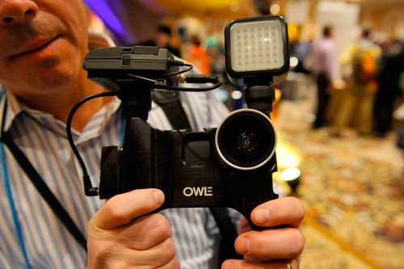
…Or stabilize your shots
Put mobile on a stationary object or brace your upper arms against your body to become a human tripod.

Slide 27
Tips for mobile video
Remove big files from your phone.
Make sure the battery is charged.
Turn off opps in the background to save power
Put the iPhone on airplane mode
Bring chargers and a juice pack.

Slide 28
Using Videolicious
Produce a 30-second vo/B-roll package or a 30-second selfie standup/B-roll package. No SOTs.
First only shoot B-roll.
Record a V.O. after you have your B-roll
Use smart phone’s native video app.
Import your assets into Videolicious to use it as your editor so you don’t inadvertently delete the video.

Slide 29
Use the Native App
Think about the story you want to tell Keep shots related to the theme.
Shoot 5 sequenced shots of FIVE SECONDS EACH.
One wide shot Establishing shot)
Two medium shots of people doing interesting things.
Two tight shots: Get intimate, show detail
Total 25 seconds. (We will add a 5 second VO later.)
Deadline 5 minutes.

Slide 30
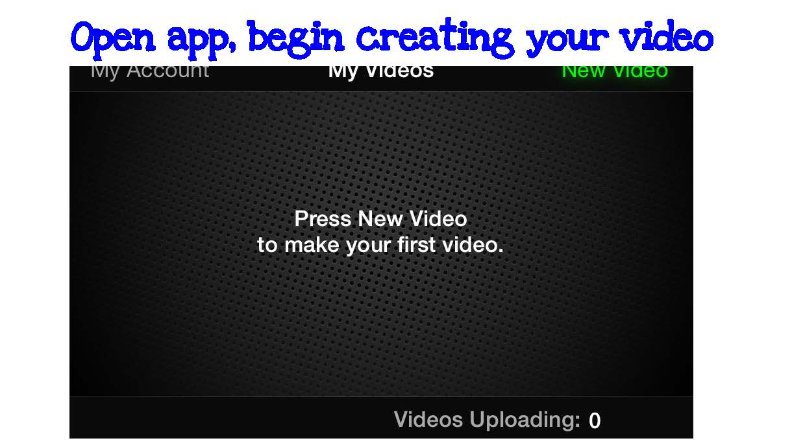

Slide 31
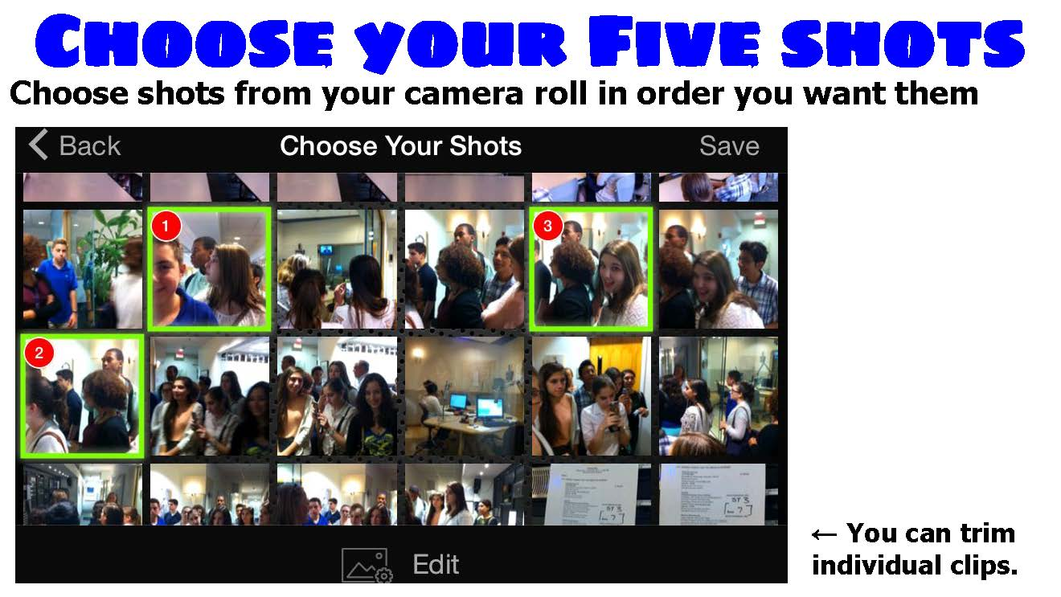

Slide 32
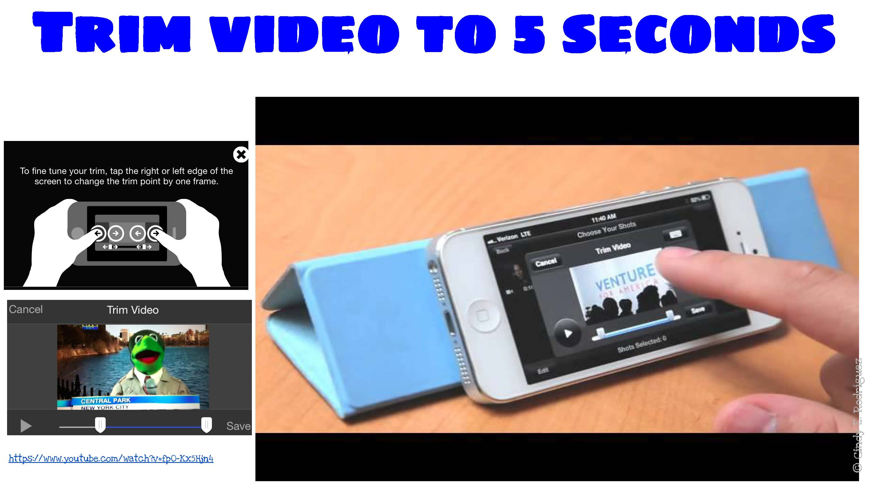

Slide 33
Review your shots then write a quick script or do it on the fly
Basic rules: One thought per sentence, keep sentences short, learn to narrate on the fly
Script template: http://j.mp/vidscripttemplate.

Slide 34
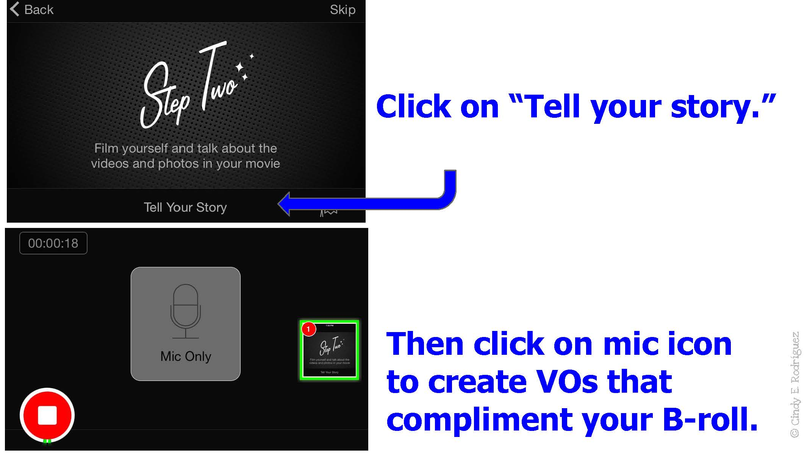

Slide 35
Tips for Recording Voice Overs
Start with a five-second VO that introduces the story.
Five seconds+ about 15 words. (Three words per second.)
Think about the background and try to find a quiet spot.
By the 6th second, begin choosing your B-Roll shots.
The free version of the app gives you 1:00 (60 seconds), but we’re keeping this package to :30.

Slide 36
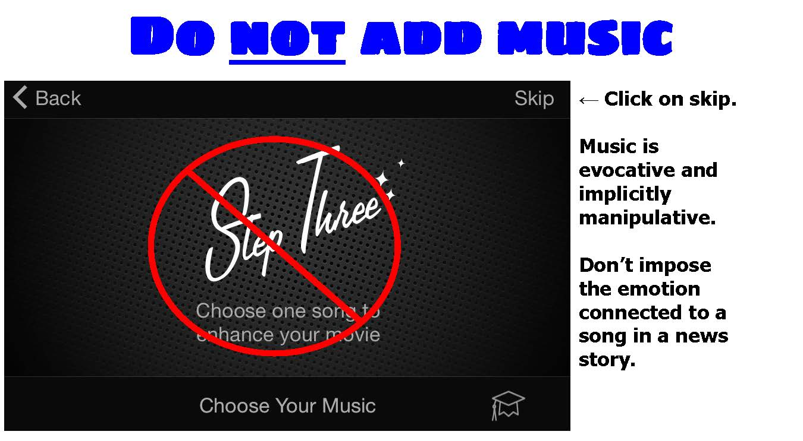

Slide 37
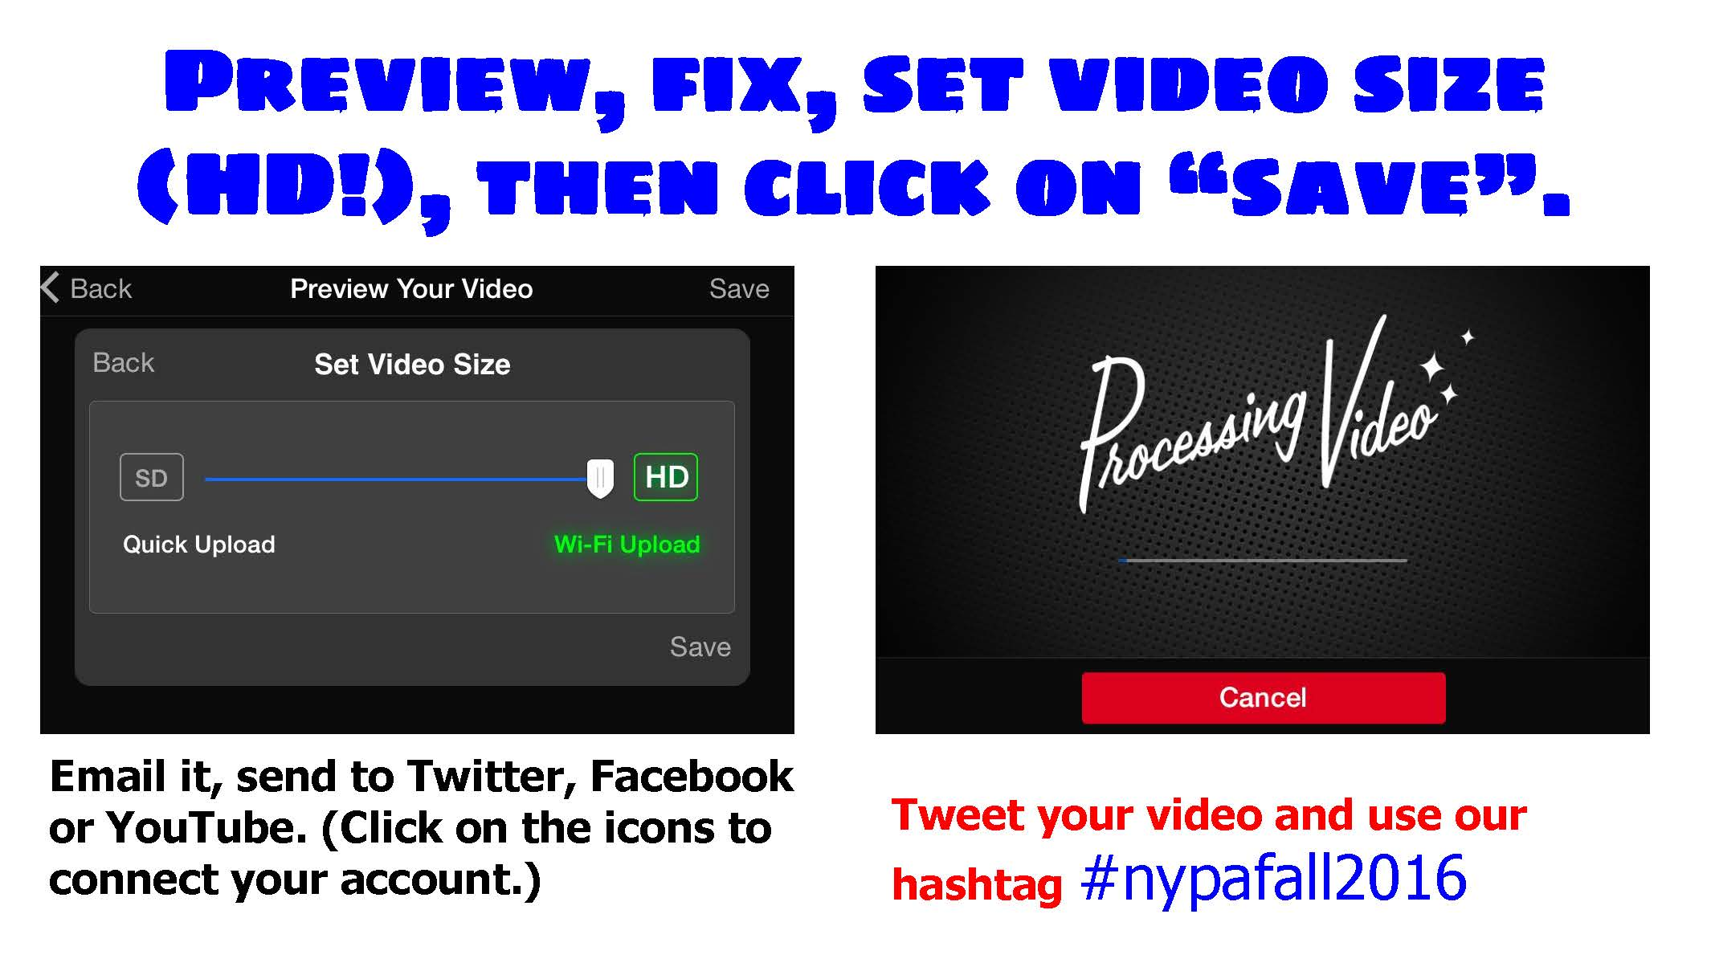

Slide 38
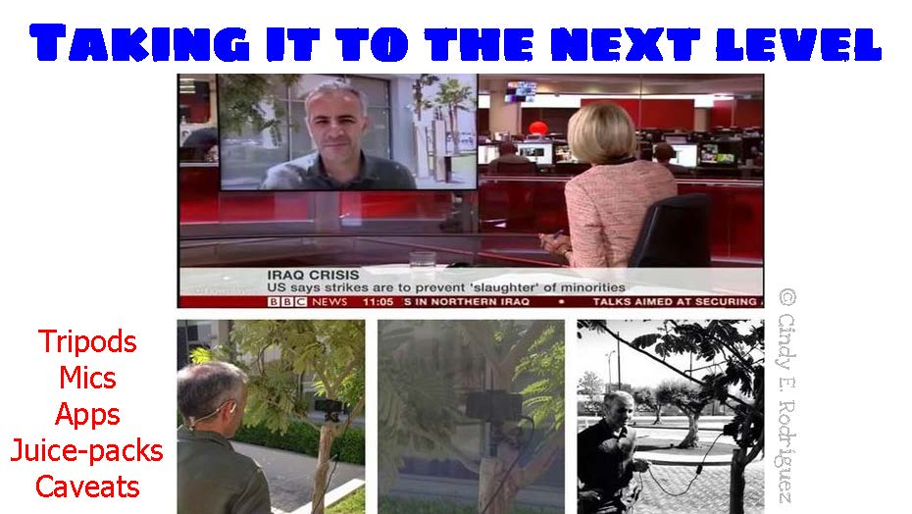

Slide 39
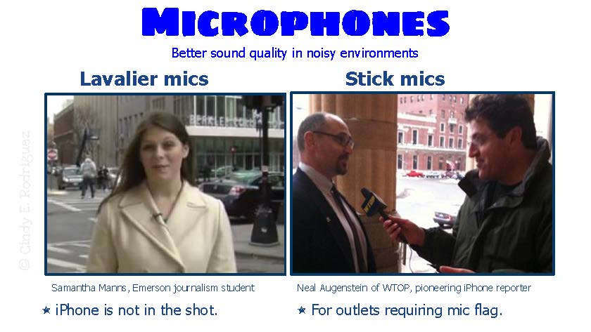

Slide 40
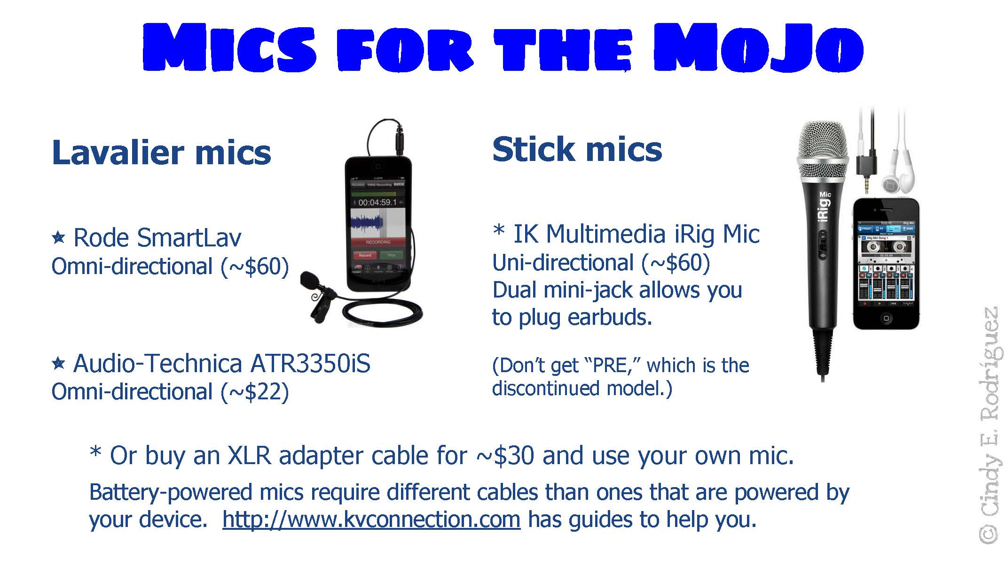

Slide 41
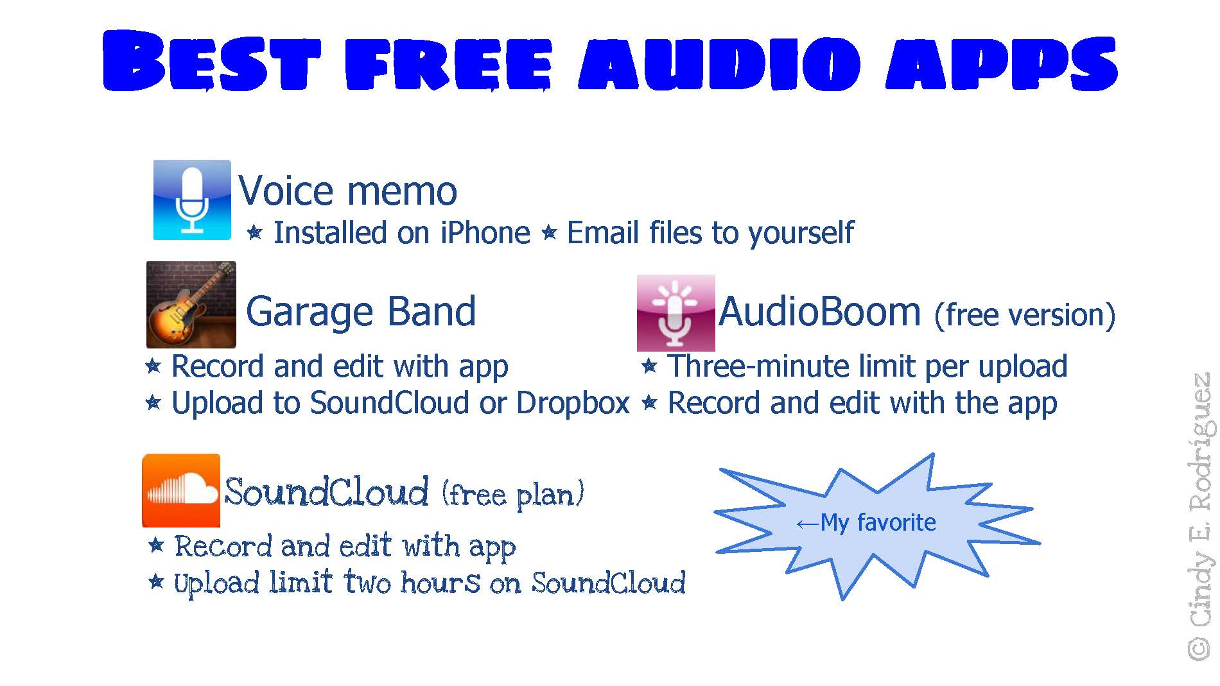

Slide 42
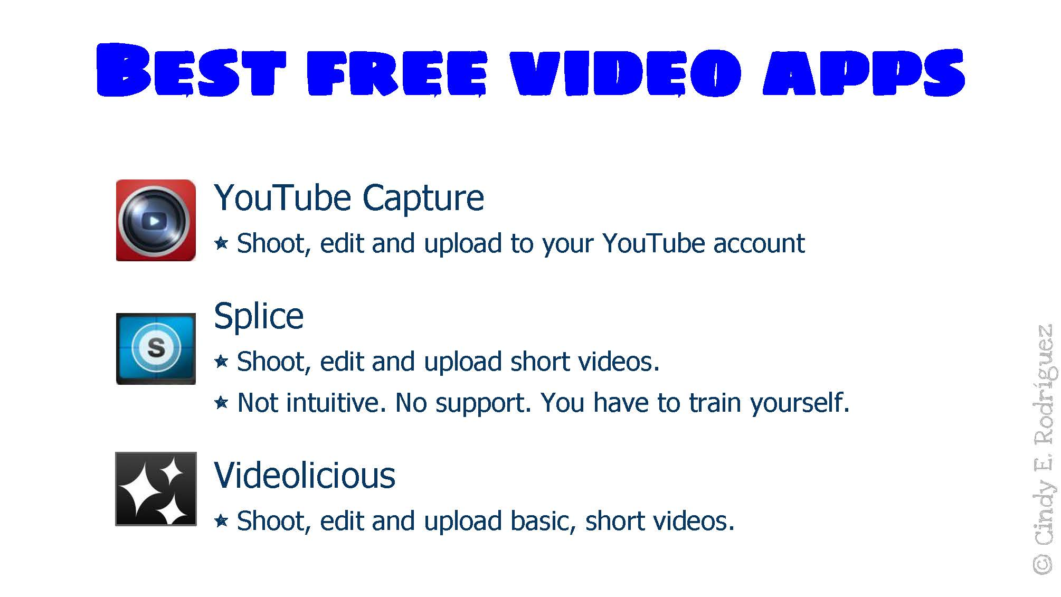

Slide 43
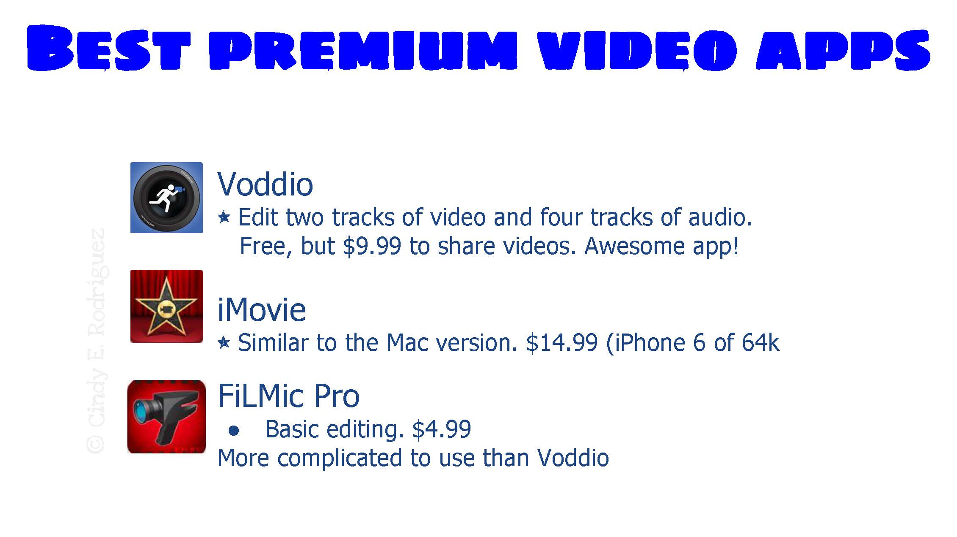

Slide 44
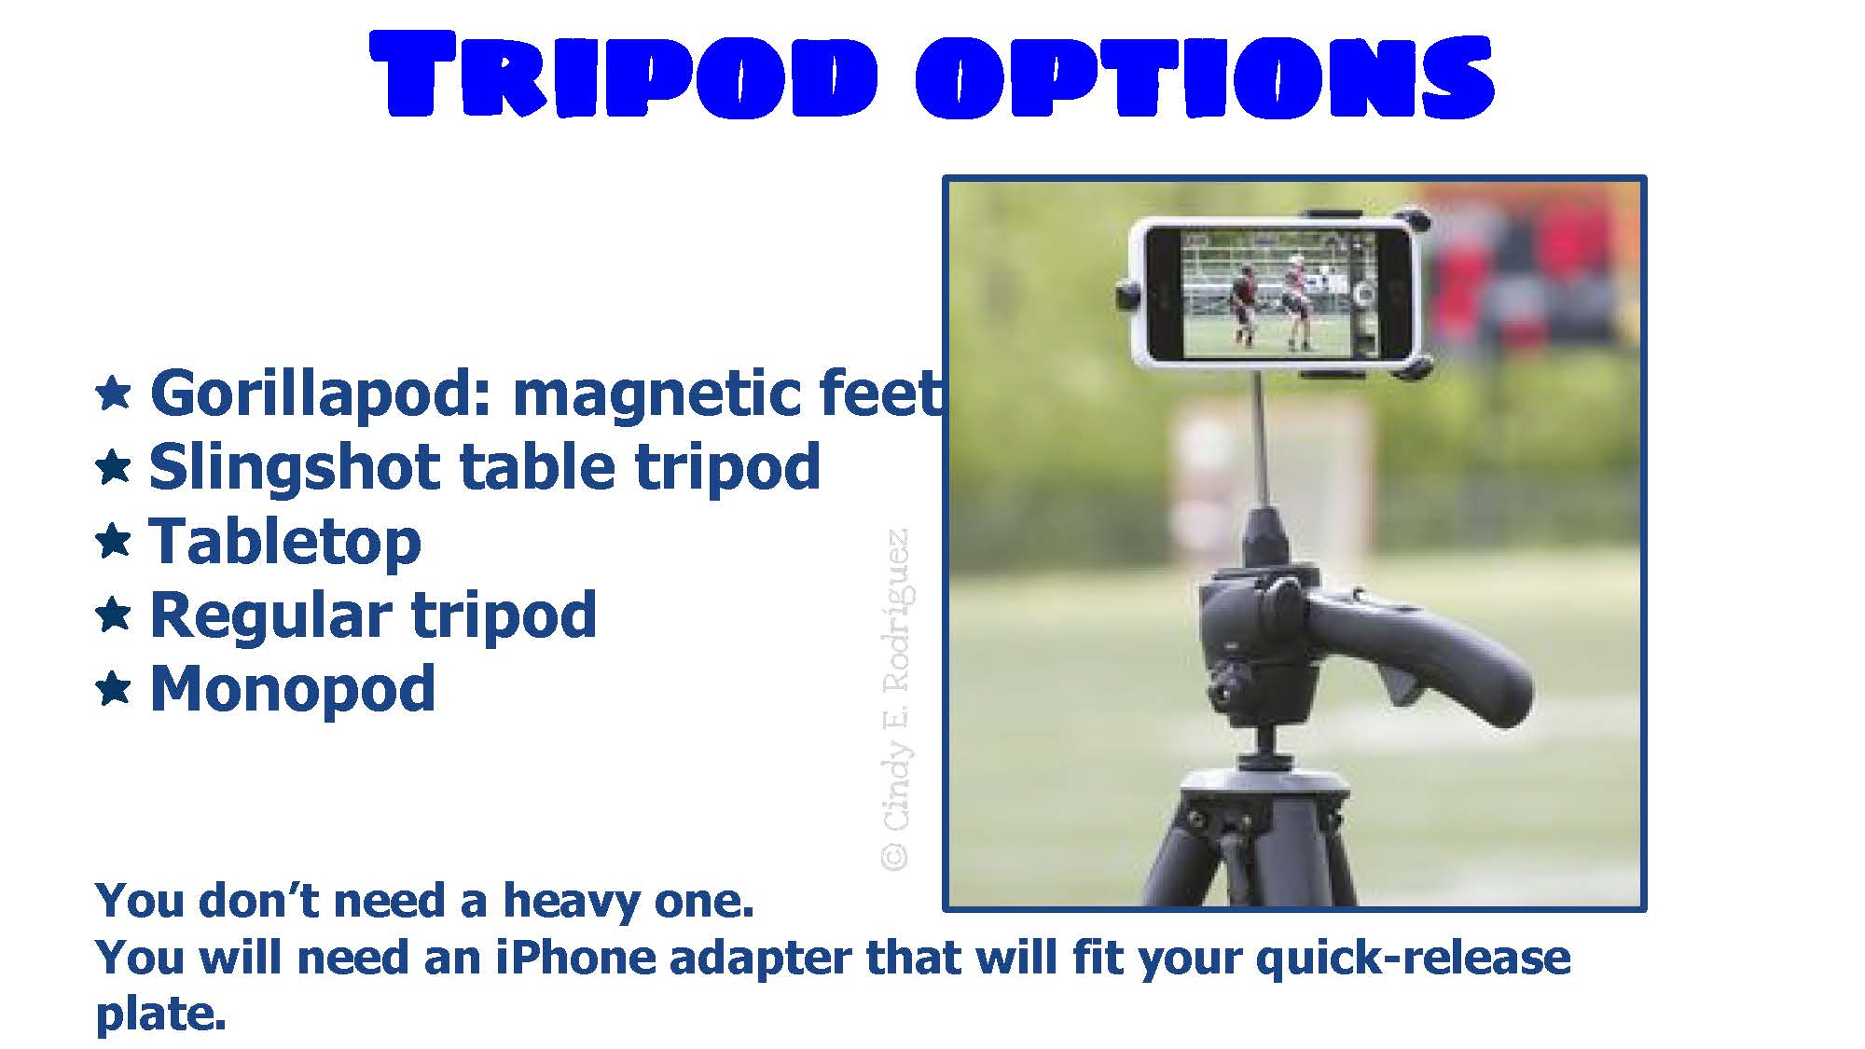

Slide 45
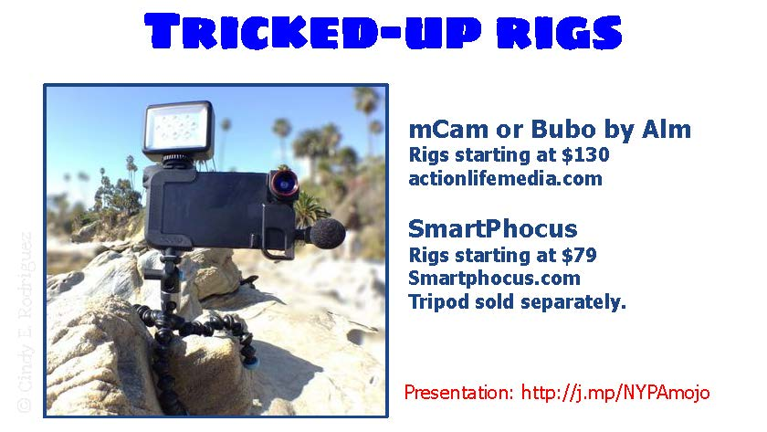

Slide 46
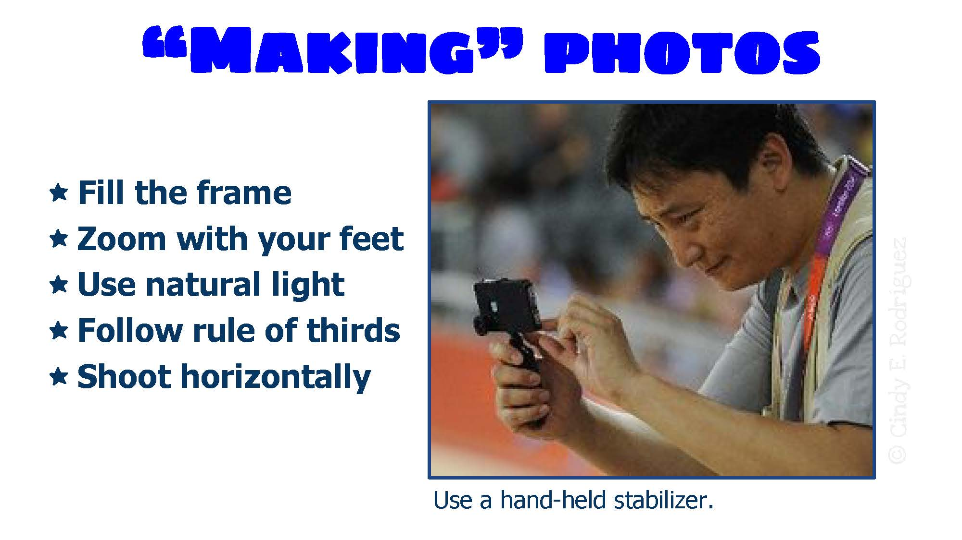

Slide 47
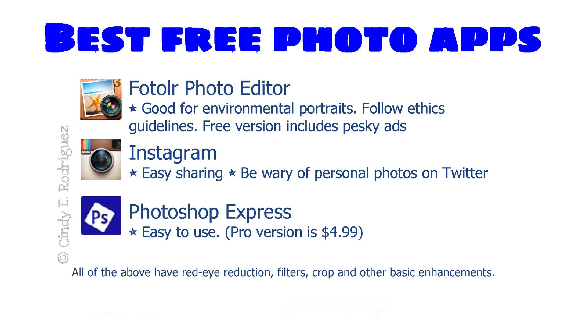

Slide 48
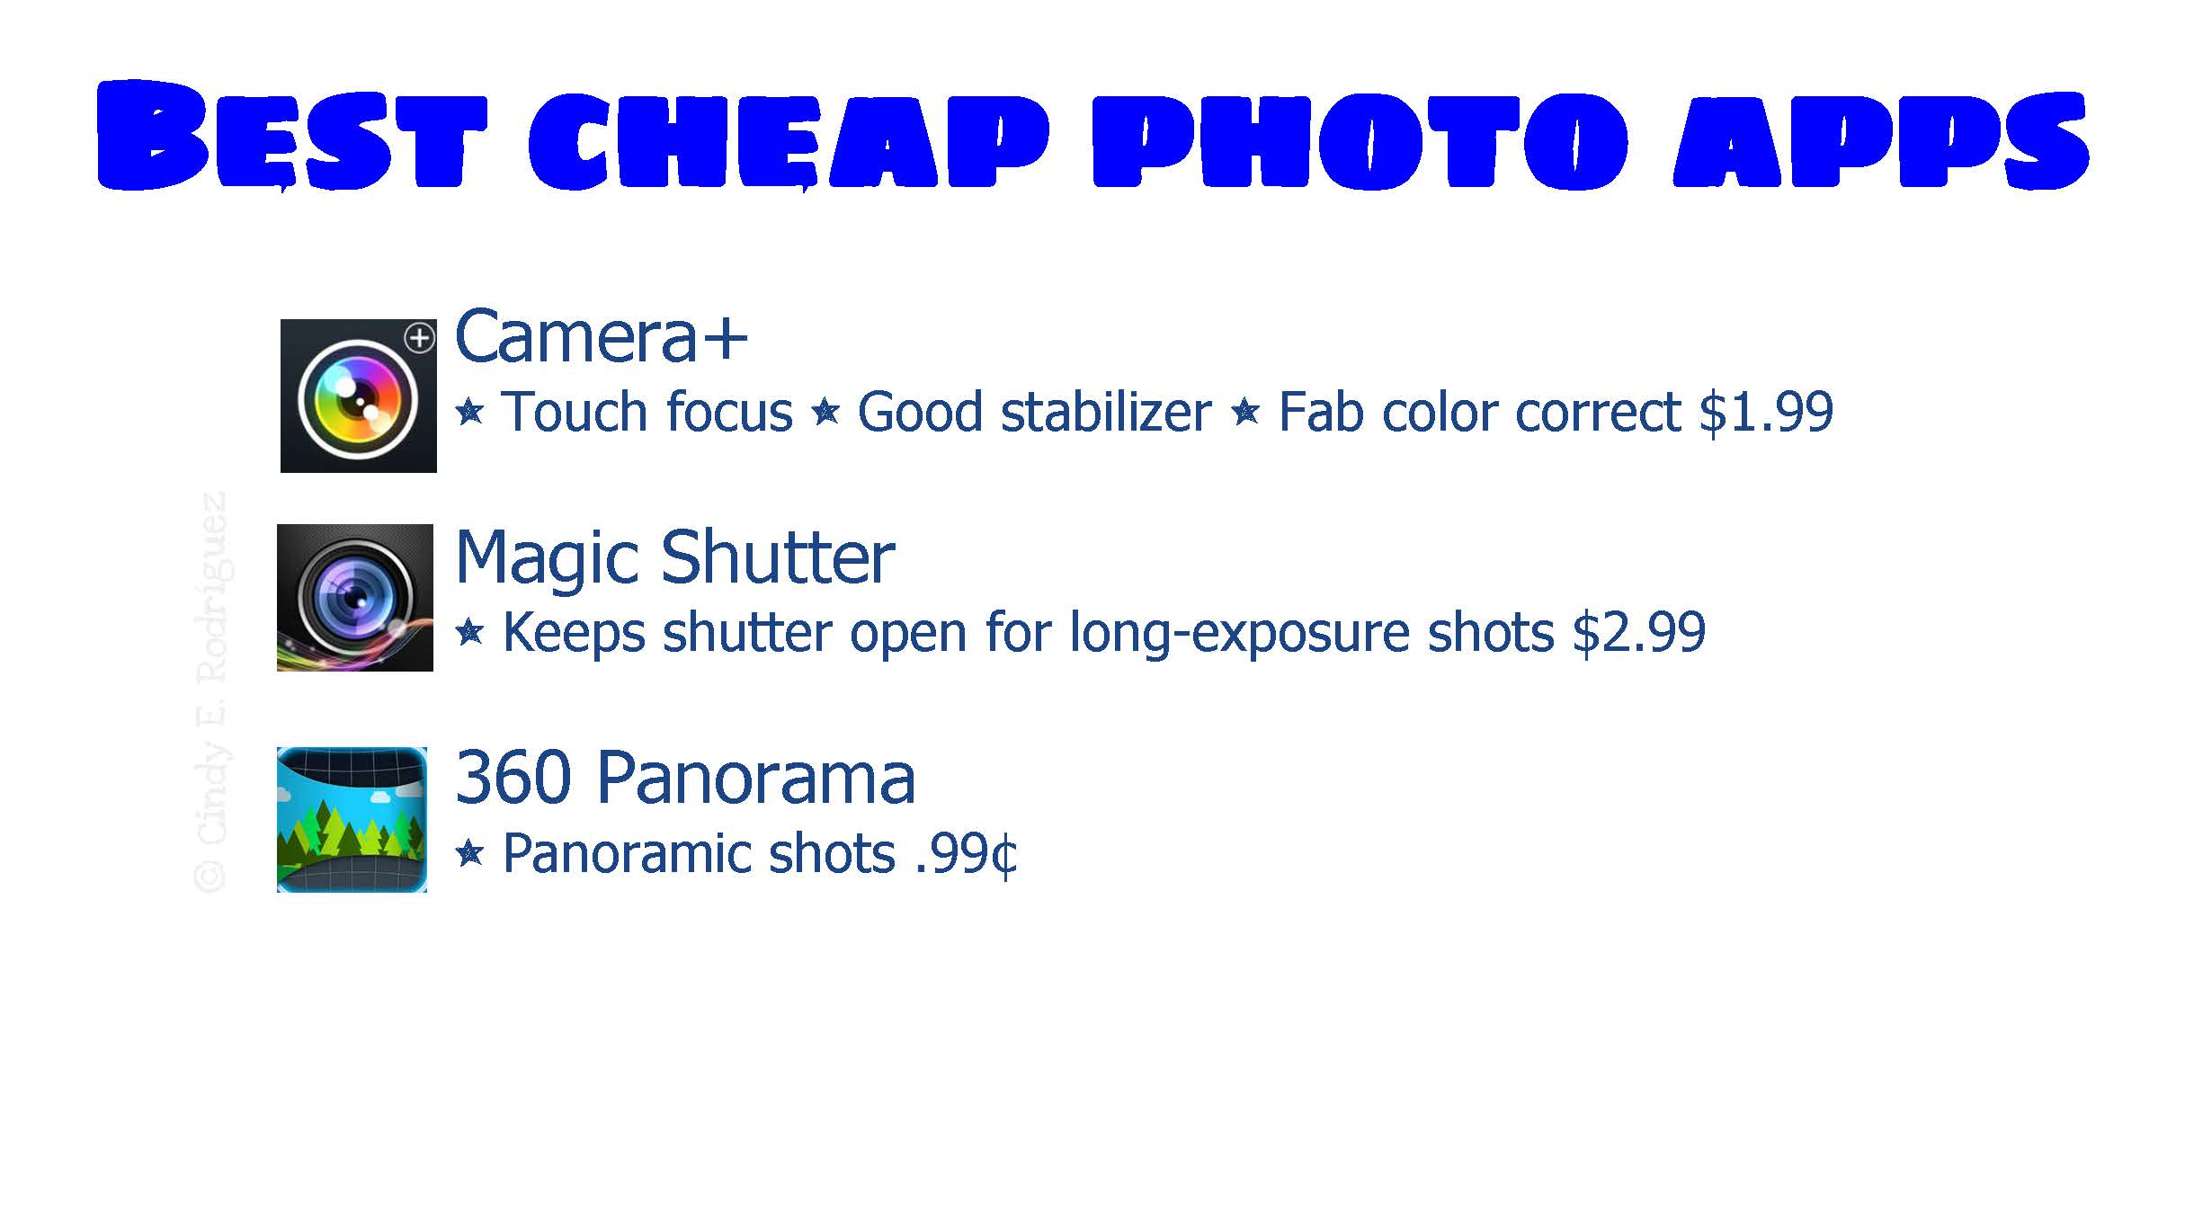

Slide 49
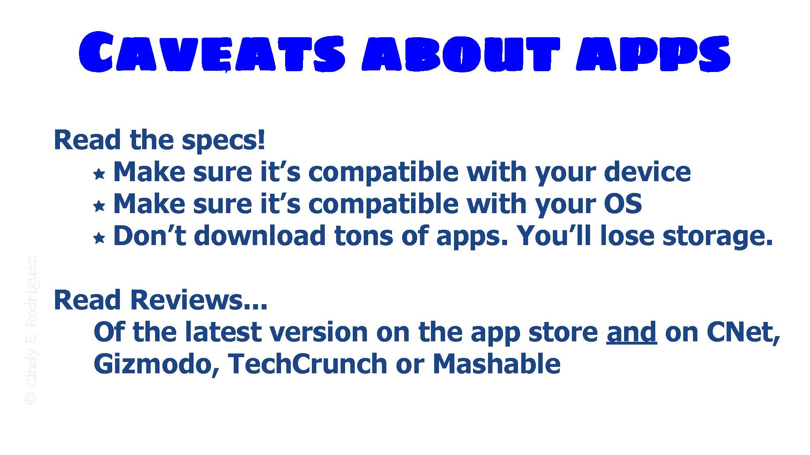

Slide 50
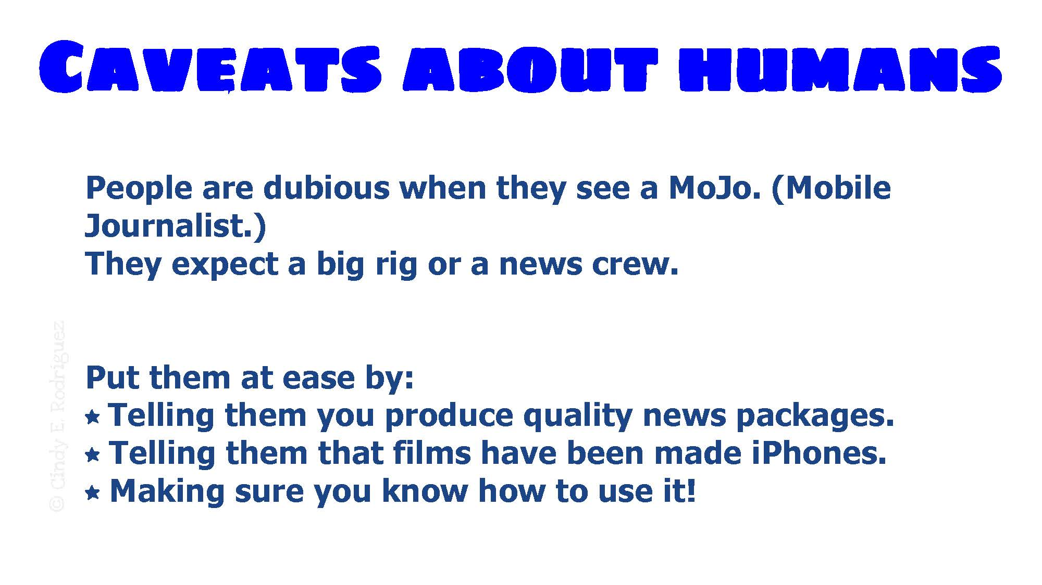

Slide 51
